Slide 1


Slide 2
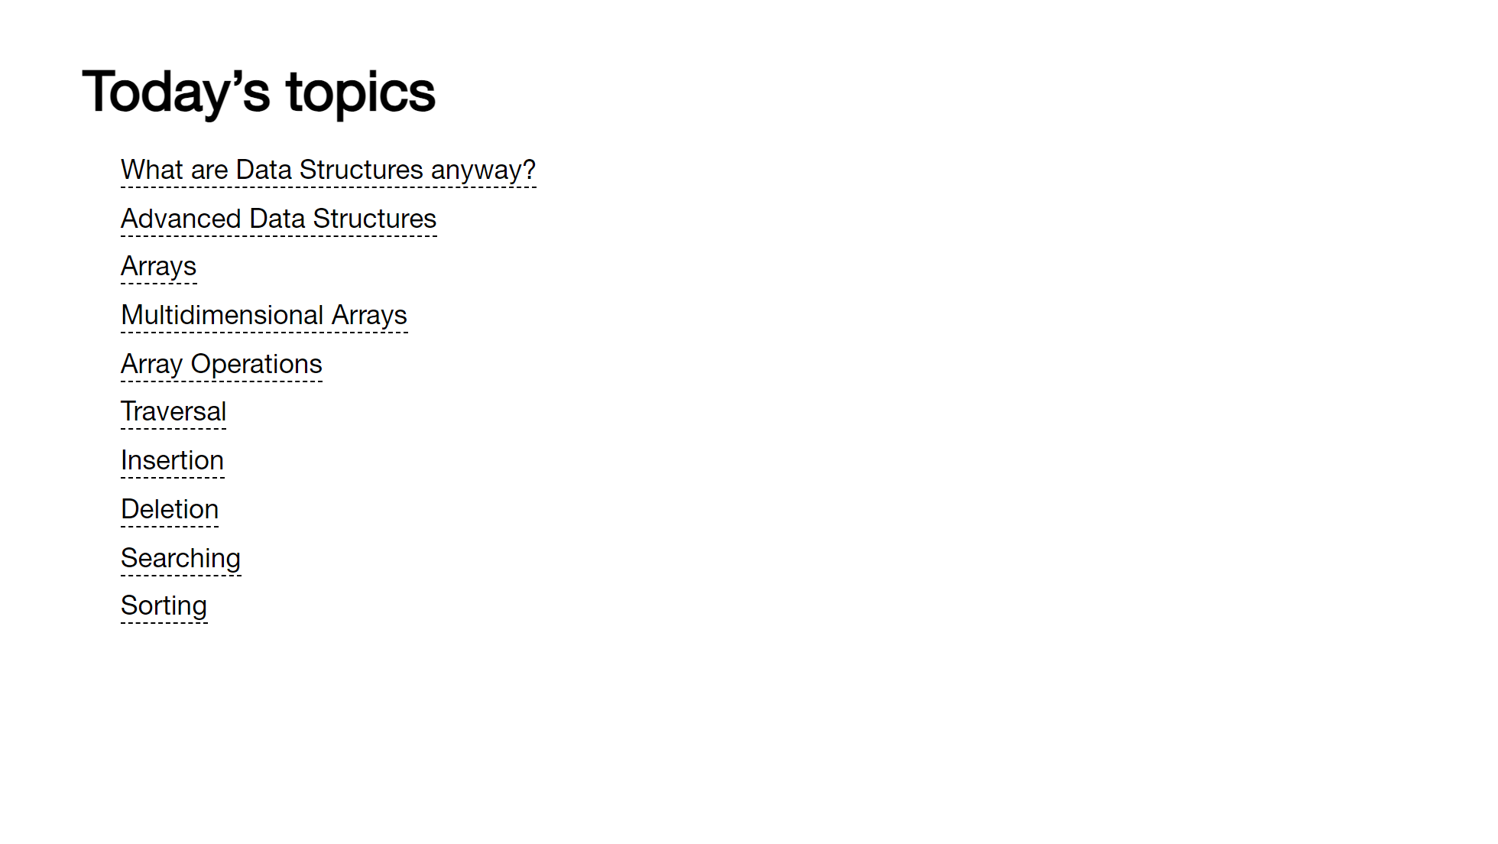

Slide 3
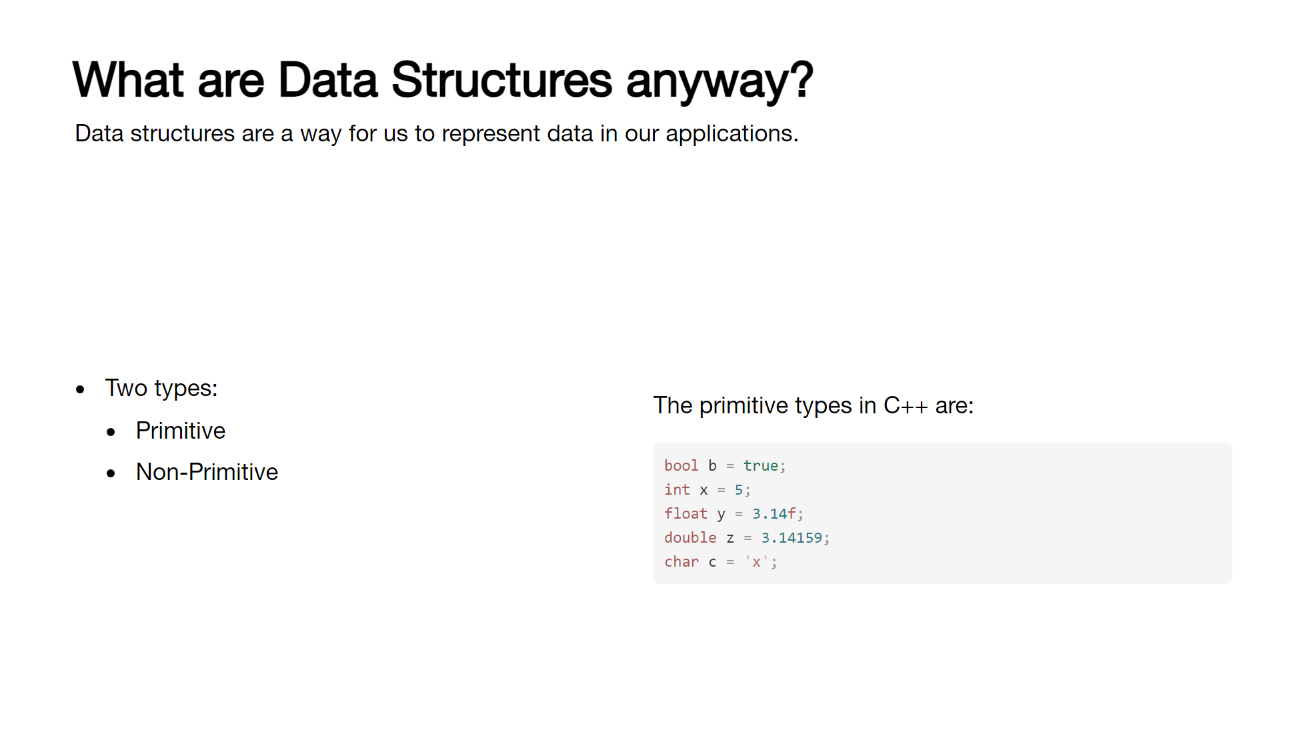
Notes:
Simply put, they’re a way for us to represent data in our applications – we look at them as two types; primitive and non-primitive (or advanced). Primitive types are usually those provided by the language itself; for example, in C++ we have bool, int, float, char, etc.

Slide 4
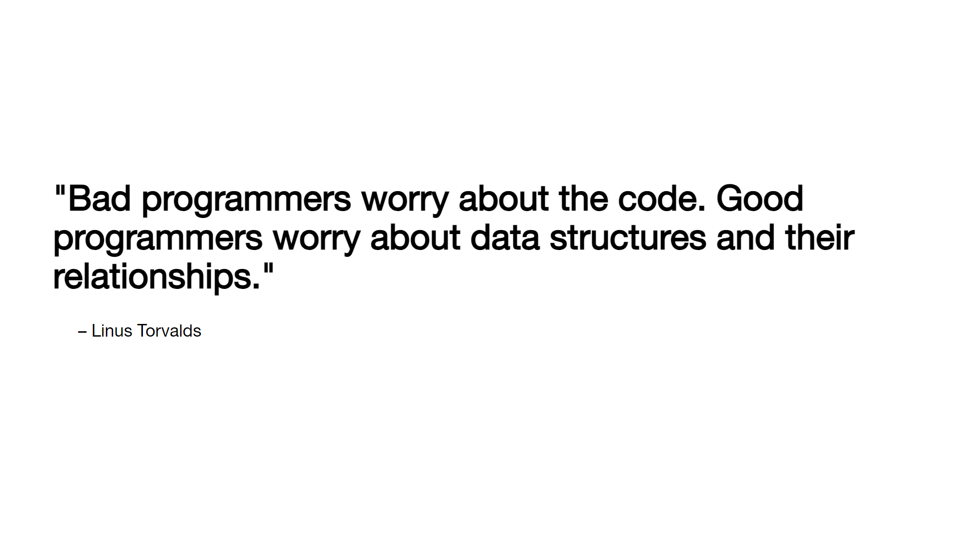

Slide 5
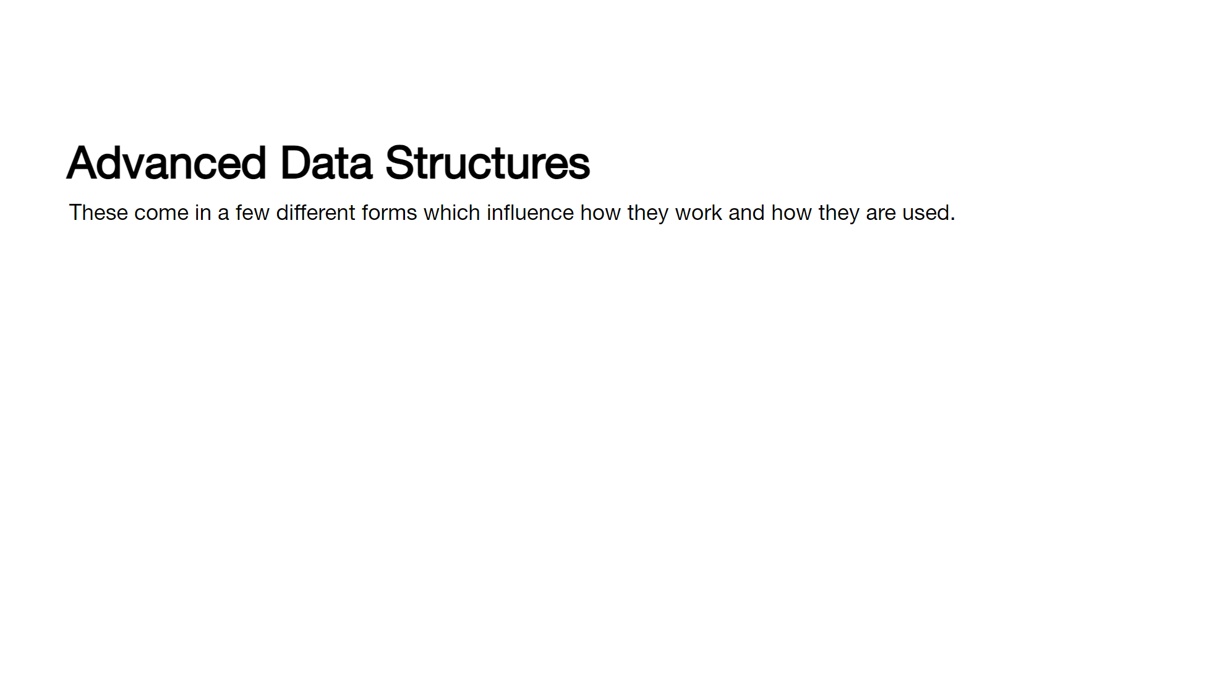
Notes:
Non-primitive structures are also called advanced data structures or abstract data types and that is the nomenclature we'll use from here on out. These are constructed from primitive types and other data structures. [click] Linear structures arrange store their elements in consecutive memory locations. [click] Static structures are fixed in size and cannot be resized. [click] Homogenous structures can only hold elements of the same type

Slide 6
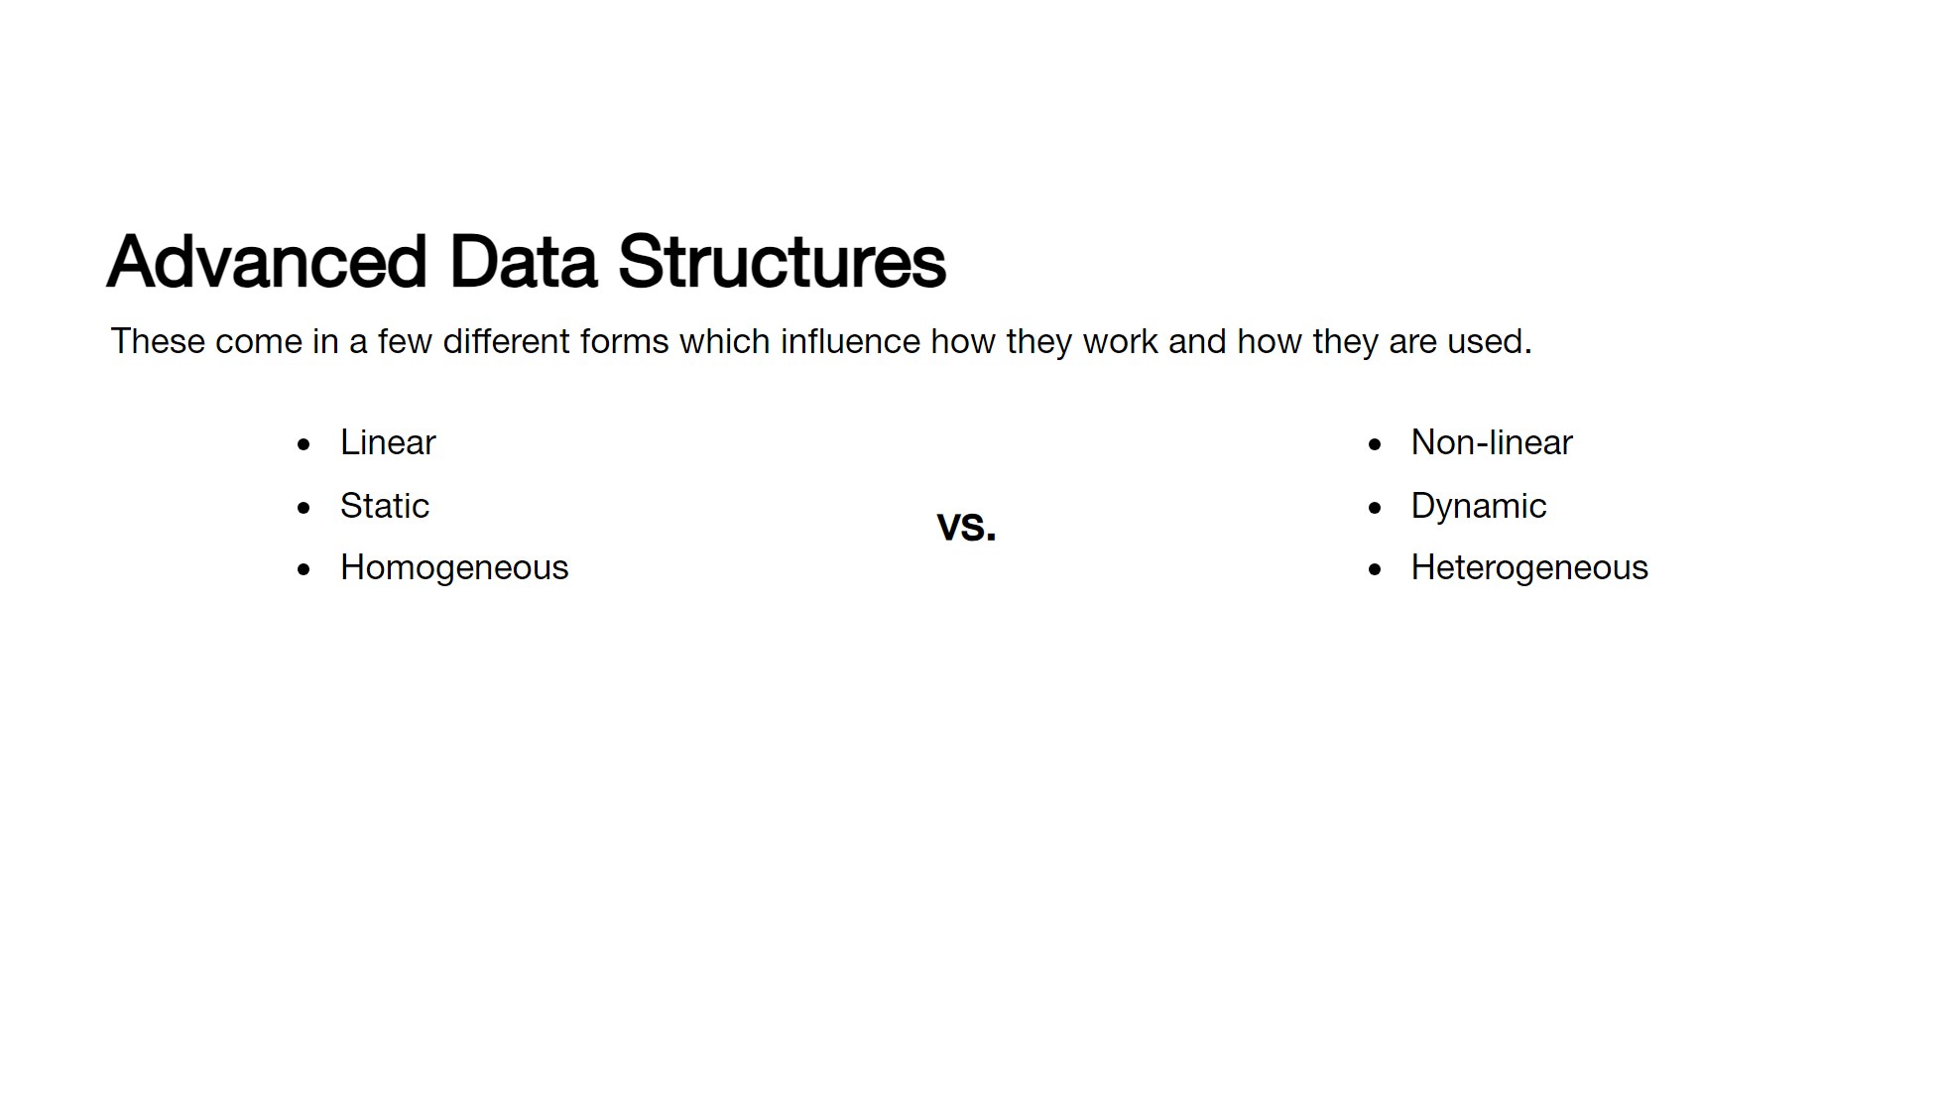
Notes:
Non-primitive structures are also called advanced data structures or abstract data types and that is the nomenclature we'll use from here on out. These are constructed from primitive types and other data structures. [click] Linear structures arrange store their elements in consecutive memory locations. [click] Static structures are fixed in size and cannot be resized. [click] Homogenous structures can only hold elements of the same type

Slide 7
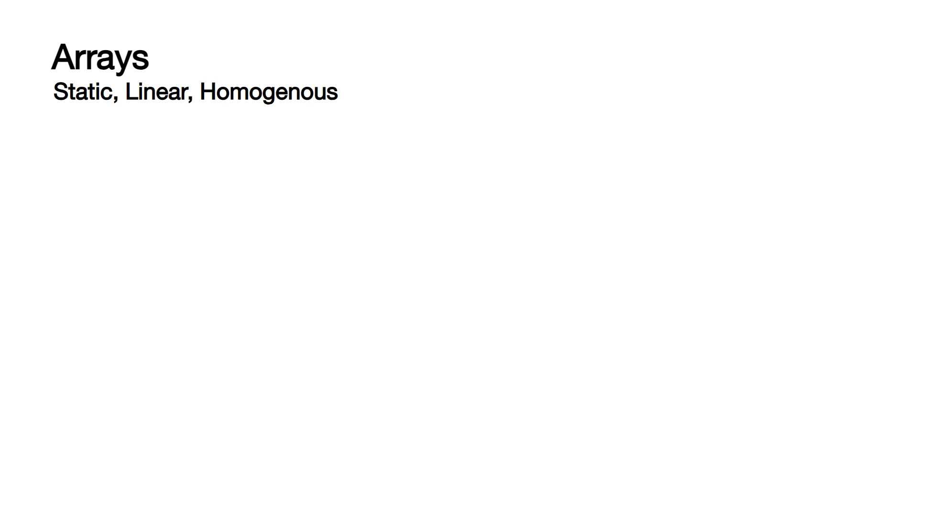
Notes:
Arrays are probably the most basic form of data structure we will look at. [click] They are linear, static and homogeneous - [click] storing memory in contiguous memory. [click] When we instantiate an array in C++, the compiler allocates the space necessary as one block, based on the size of the specified type and the fixed size of the array. [click] So to create an array of integers, we do this - here we're also providing a set of values to fill the array with [click] when we specify elements at compile-time, we do not need to specify a size. [click] If we do specify a size and offer up fewer elements, the remaining elements will be set to zero (or the default value for the type). [click] we can also use the std::array template class, which is a bit more modern and offers some additional functionality. [click] If we really, really need an array allocated at runtime, then we need to dynamically allocate it using the new[] operator [click] and then remember to delete that array once we're done with it. [click] Arrays are zero-indexed, so to get the first element we use index 0 [click] to get the last, array size - 1. [click] If we try and access an array with a value below 0 or above the array size - 1, we are out of bounds which can cause all sorts of issues, the best of which is a straight crash.

Slide 8
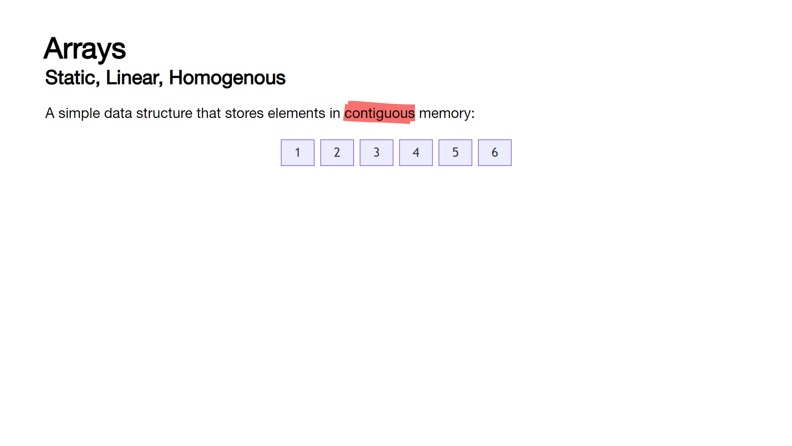
Notes:
Arrays are probably the most basic form of data structure we will look at. [click] They are linear, static and homogeneous - [click] storing memory in contiguous memory. [click] When we instantiate an array in C++, the compiler allocates the space necessary as one block, based on the size of the specified type and the fixed size of the array. [click] So to create an array of integers, we do this - here we're also providing a set of values to fill the array with [click] when we specify elements at compile-time, we do not need to specify a size. [click] If we do specify a size and offer up fewer elements, the remaining elements will be set to zero (or the default value for the type). [click] we can also use the std::array template class, which is a bit more modern and offers some additional functionality. [click] If we really, really need an array allocated at runtime, then we need to dynamically allocate it using the new[] operator [click] and then remember to delete that array once we're done with it. [click] Arrays are zero-indexed, so to get the first element we use index 0 [click] to get the last, array size - 1. [click] If we try and access an array with a value below 0 or above the array size - 1, we are out of bounds which can cause all sorts of issues, the best of which is a straight crash.

Slide 9
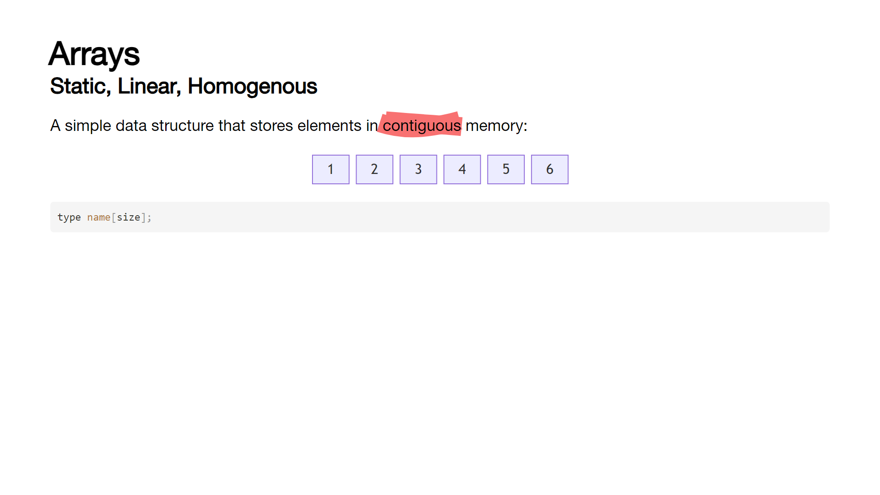
Notes:
Arrays are probably the most basic form of data structure we will look at. [click] They are linear, static and homogeneous - [click] storing memory in contiguous memory. [click] When we instantiate an array in C++, the compiler allocates the space necessary as one block, based on the size of the specified type and the fixed size of the array. [click] So to create an array of integers, we do this - here we're also providing a set of values to fill the array with [click] when we specify elements at compile-time, we do not need to specify a size. [click] If we do specify a size and offer up fewer elements, the remaining elements will be set to zero (or the default value for the type). [click] we can also use the std::array template class, which is a bit more modern and offers some additional functionality. [click] If we really, really need an array allocated at runtime, then we need to dynamically allocate it using the new[] operator [click] and then remember to delete that array once we're done with it. [click] Arrays are zero-indexed, so to get the first element we use index 0 [click] to get the last, array size - 1. [click] If we try and access an array with a value below 0 or above the array size - 1, we are out of bounds which can cause all sorts of issues, the best of which is a straight crash.

Slide 10
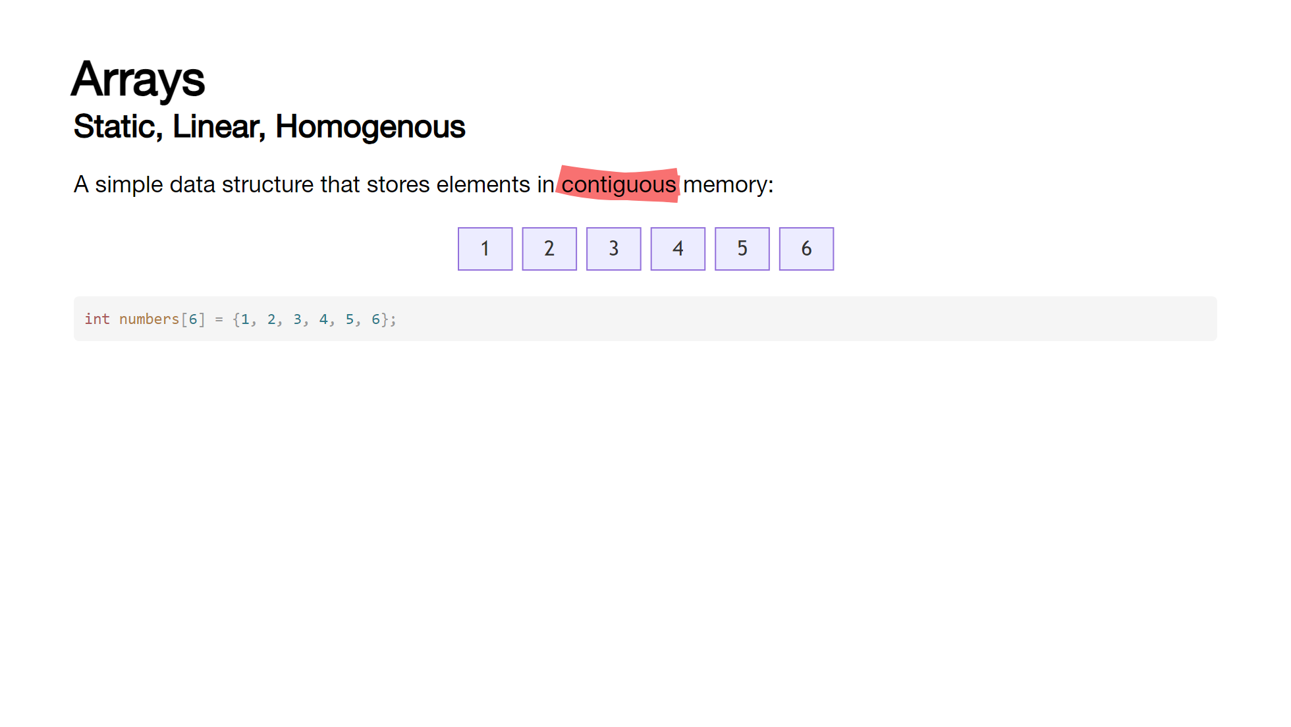
Notes:
Arrays are probably the most basic form of data structure we will look at. [click] They are linear, static and homogeneous - [click] storing memory in contiguous memory. [click] When we instantiate an array in C++, the compiler allocates the space necessary as one block, based on the size of the specified type and the fixed size of the array. [click] So to create an array of integers, we do this - here we're also providing a set of values to fill the array with [click] when we specify elements at compile-time, we do not need to specify a size. [click] If we do specify a size and offer up fewer elements, the remaining elements will be set to zero (or the default value for the type). [click] we can also use the std::array template class, which is a bit more modern and offers some additional functionality. [click] If we really, really need an array allocated at runtime, then we need to dynamically allocate it using the new[] operator [click] and then remember to delete that array once we're done with it. [click] Arrays are zero-indexed, so to get the first element we use index 0 [click] to get the last, array size - 1. [click] If we try and access an array with a value below 0 or above the array size - 1, we are out of bounds which can cause all sorts of issues, the best of which is a straight crash.

Slide 11

Notes:
Arrays are probably the most basic form of data structure we will look at. [click] They are linear, static and homogeneous - [click] storing memory in contiguous memory. [click] When we instantiate an array in C++, the compiler allocates the space necessary as one block, based on the size of the specified type and the fixed size of the array. [click] So to create an array of integers, we do this - here we're also providing a set of values to fill the array with [click] when we specify elements at compile-time, we do not need to specify a size. [click] If we do specify a size and offer up fewer elements, the remaining elements will be set to zero (or the default value for the type). [click] we can also use the std::array template class, which is a bit more modern and offers some additional functionality. [click] If we really, really need an array allocated at runtime, then we need to dynamically allocate it using the new[] operator [click] and then remember to delete that array once we're done with it. [click] Arrays are zero-indexed, so to get the first element we use index 0 [click] to get the last, array size - 1. [click] If we try and access an array with a value below 0 or above the array size - 1, we are out of bounds which can cause all sorts of issues, the best of which is a straight crash.

Slide 12
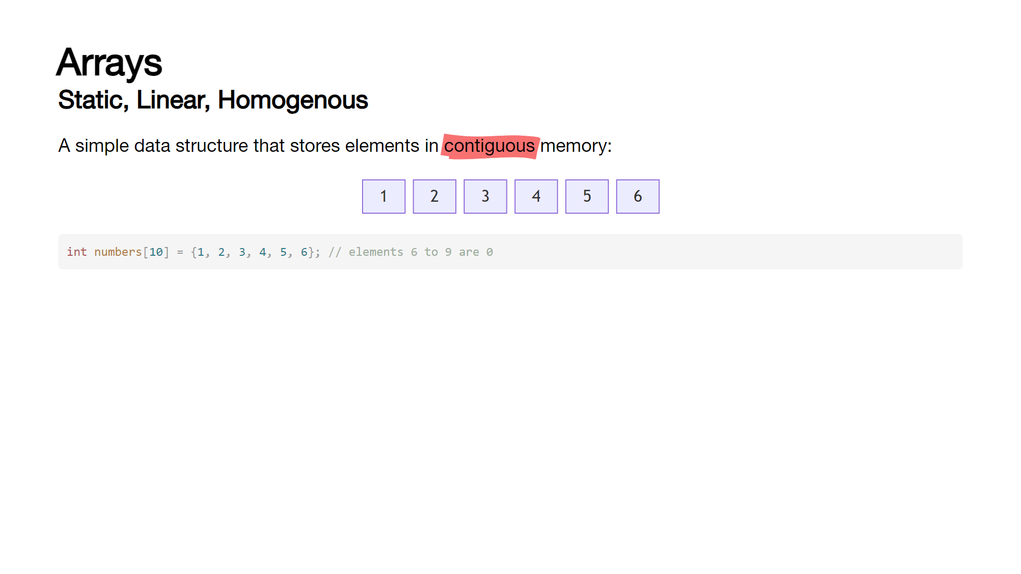
Notes:
Arrays are probably the most basic form of data structure we will look at. [click] They are linear, static and homogeneous - [click] storing memory in contiguous memory. [click] When we instantiate an array in C++, the compiler allocates the space necessary as one block, based on the size of the specified type and the fixed size of the array. [click] So to create an array of integers, we do this - here we're also providing a set of values to fill the array with [click] when we specify elements at compile-time, we do not need to specify a size. [click] If we do specify a size and offer up fewer elements, the remaining elements will be set to zero (or the default value for the type). [click] we can also use the std::array template class, which is a bit more modern and offers some additional functionality. [click] If we really, really need an array allocated at runtime, then we need to dynamically allocate it using the new[] operator [click] and then remember to delete that array once we're done with it. [click] Arrays are zero-indexed, so to get the first element we use index 0 [click] to get the last, array size - 1. [click] If we try and access an array with a value below 0 or above the array size - 1, we are out of bounds which can cause all sorts of issues, the best of which is a straight crash.

Slide 13
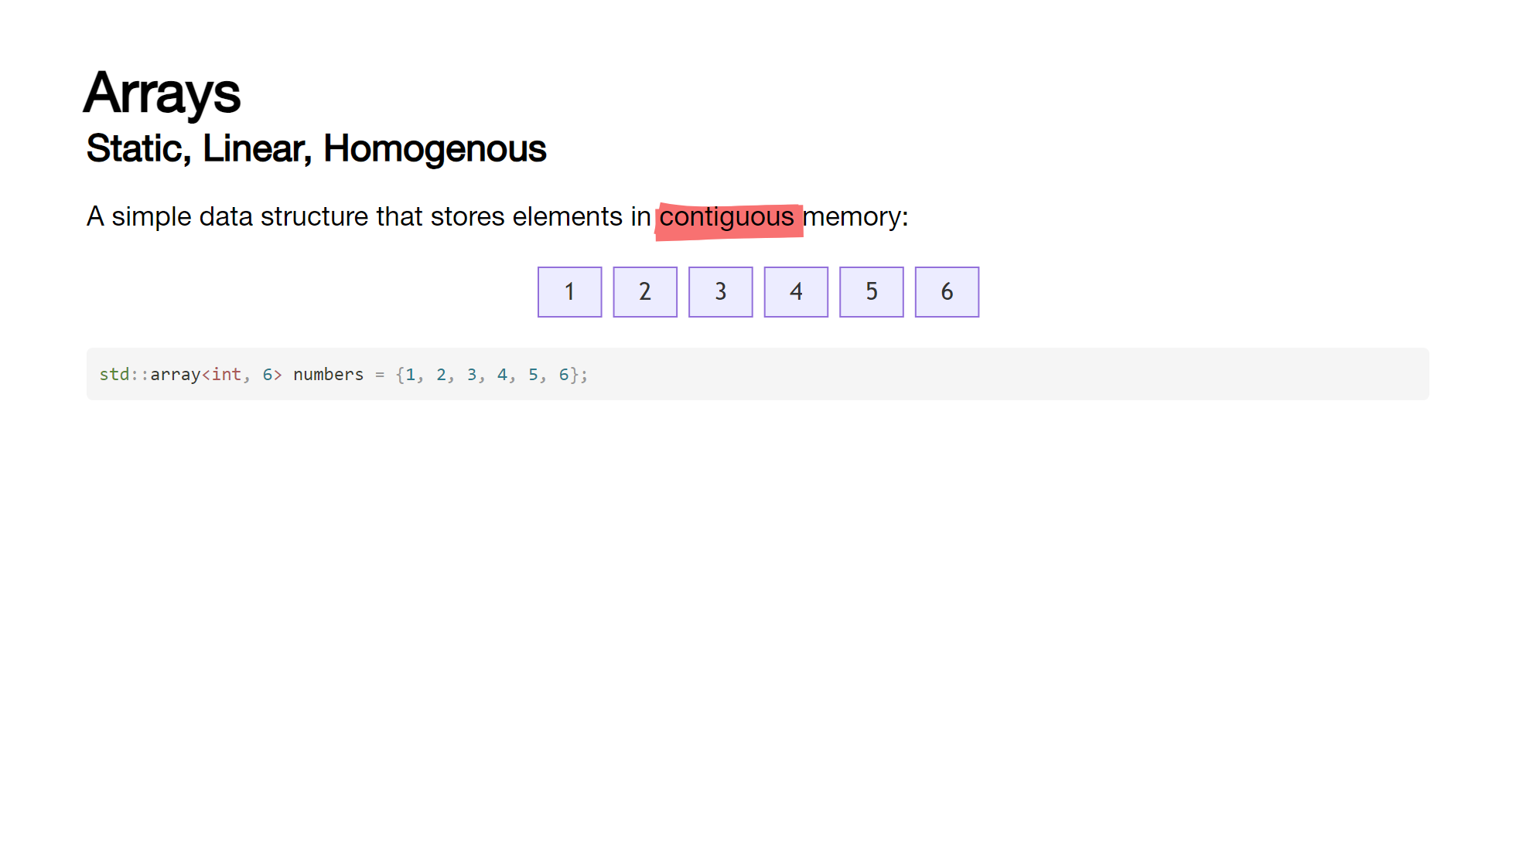
Notes:
Arrays are probably the most basic form of data structure we will look at. [click] They are linear, static and homogeneous - [click] storing memory in contiguous memory. [click] When we instantiate an array in C++, the compiler allocates the space necessary as one block, based on the size of the specified type and the fixed size of the array. [click] So to create an array of integers, we do this - here we're also providing a set of values to fill the array with [click] when we specify elements at compile-time, we do not need to specify a size. [click] If we do specify a size and offer up fewer elements, the remaining elements will be set to zero (or the default value for the type). [click] we can also use the std::array template class, which is a bit more modern and offers some additional functionality. [click] If we really, really need an array allocated at runtime, then we need to dynamically allocate it using the new[] operator [click] and then remember to delete that array once we're done with it. [click] Arrays are zero-indexed, so to get the first element we use index 0 [click] to get the last, array size - 1. [click] If we try and access an array with a value below 0 or above the array size - 1, we are out of bounds which can cause all sorts of issues, the best of which is a straight crash.

Slide 14

Notes:
Arrays are probably the most basic form of data structure we will look at. [click] They are linear, static and homogeneous - [click] storing memory in contiguous memory. [click] When we instantiate an array in C++, the compiler allocates the space necessary as one block, based on the size of the specified type and the fixed size of the array. [click] So to create an array of integers, we do this - here we're also providing a set of values to fill the array with [click] when we specify elements at compile-time, we do not need to specify a size. [click] If we do specify a size and offer up fewer elements, the remaining elements will be set to zero (or the default value for the type). [click] we can also use the std::array template class, which is a bit more modern and offers some additional functionality. [click] If we really, really need an array allocated at runtime, then we need to dynamically allocate it using the new[] operator [click] and then remember to delete that array once we're done with it. [click] Arrays are zero-indexed, so to get the first element we use index 0 [click] to get the last, array size - 1. [click] If we try and access an array with a value below 0 or above the array size - 1, we are out of bounds which can cause all sorts of issues, the best of which is a straight crash.

Slide 15

Notes:
Arrays are probably the most basic form of data structure we will look at. [click] They are linear, static and homogeneous - [click] storing memory in contiguous memory. [click] When we instantiate an array in C++, the compiler allocates the space necessary as one block, based on the size of the specified type and the fixed size of the array. [click] So to create an array of integers, we do this - here we're also providing a set of values to fill the array with [click] when we specify elements at compile-time, we do not need to specify a size. [click] If we do specify a size and offer up fewer elements, the remaining elements will be set to zero (or the default value for the type). [click] we can also use the std::array template class, which is a bit more modern and offers some additional functionality. [click] If we really, really need an array allocated at runtime, then we need to dynamically allocate it using the new[] operator [click] and then remember to delete that array once we're done with it. [click] Arrays are zero-indexed, so to get the first element we use index 0 [click] to get the last, array size - 1. [click] If we try and access an array with a value below 0 or above the array size - 1, we are out of bounds which can cause all sorts of issues, the best of which is a straight crash.

Slide 16
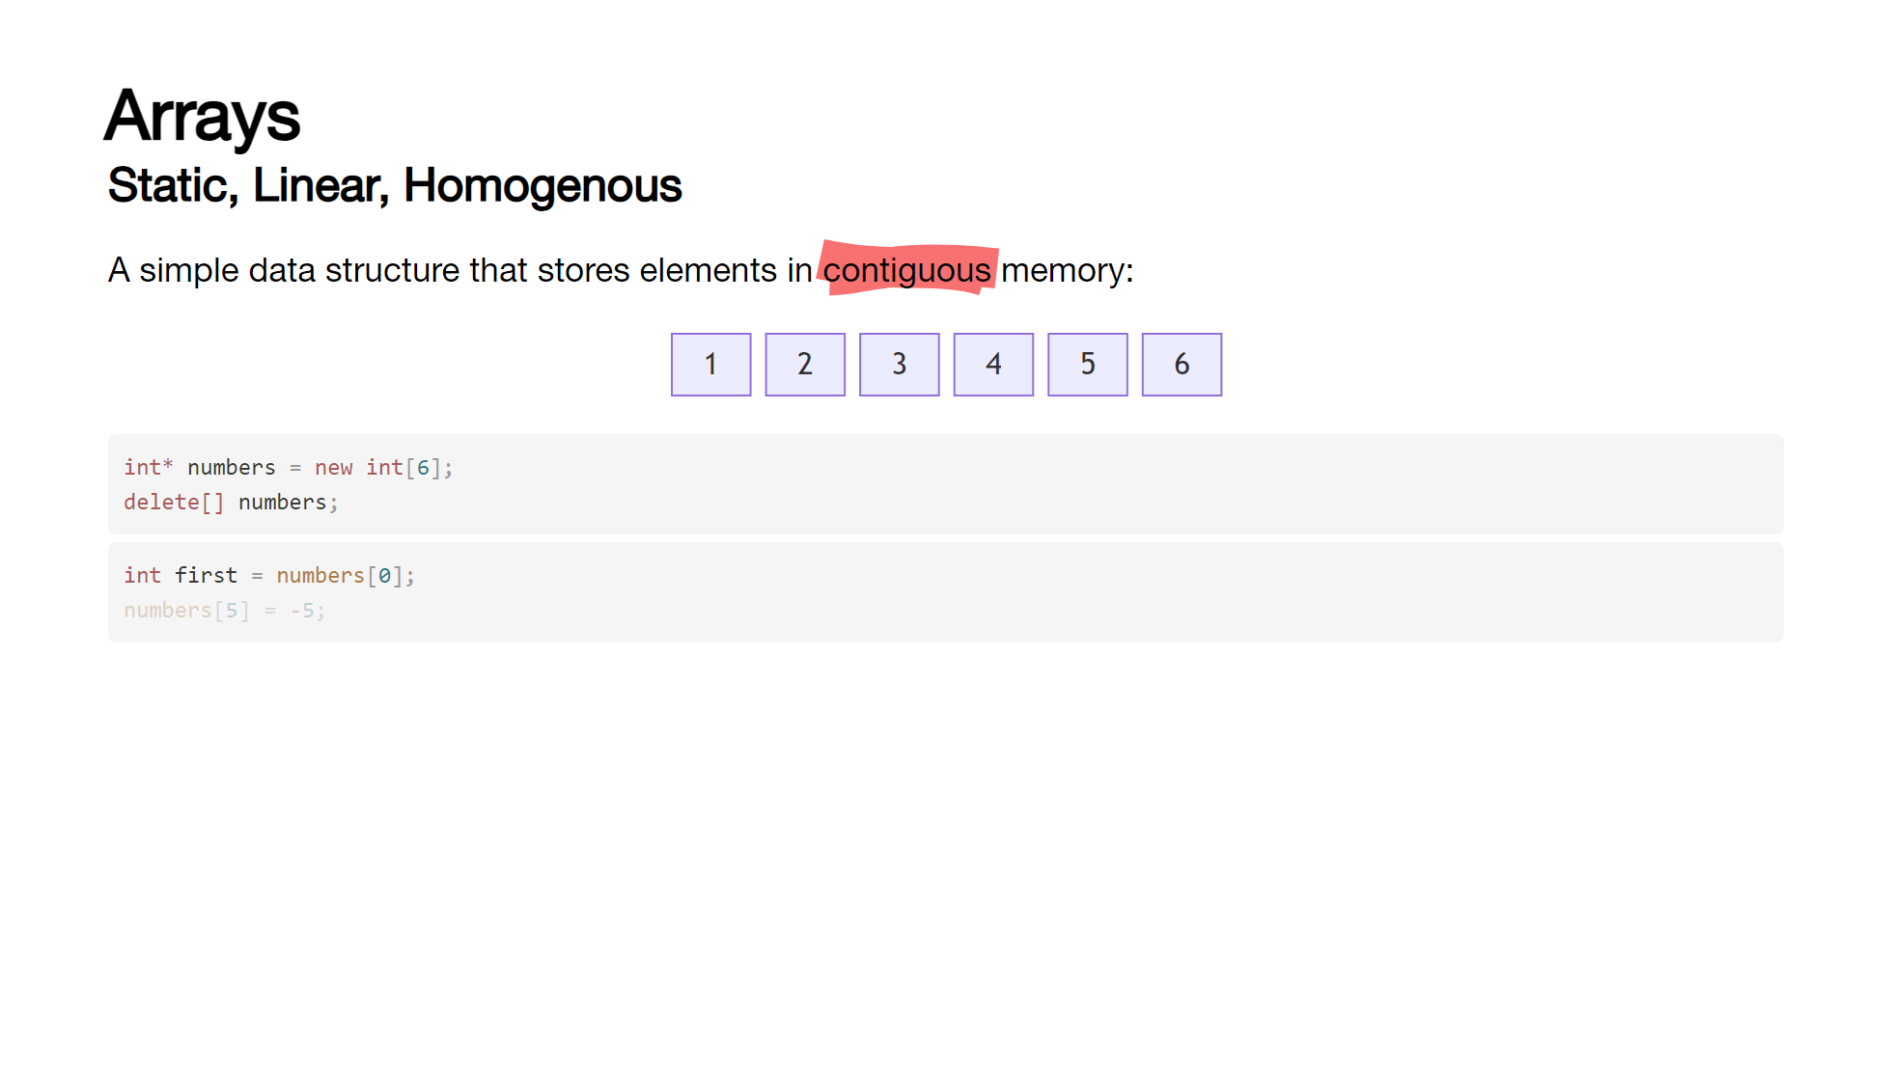
Notes:
Arrays are probably the most basic form of data structure we will look at. [click] They are linear, static and homogeneous - [click] storing memory in contiguous memory. [click] When we instantiate an array in C++, the compiler allocates the space necessary as one block, based on the size of the specified type and the fixed size of the array. [click] So to create an array of integers, we do this - here we're also providing a set of values to fill the array with [click] when we specify elements at compile-time, we do not need to specify a size. [click] If we do specify a size and offer up fewer elements, the remaining elements will be set to zero (or the default value for the type). [click] we can also use the std::array template class, which is a bit more modern and offers some additional functionality. [click] If we really, really need an array allocated at runtime, then we need to dynamically allocate it using the new[] operator [click] and then remember to delete that array once we're done with it. [click] Arrays are zero-indexed, so to get the first element we use index 0 [click] to get the last, array size - 1. [click] If we try and access an array with a value below 0 or above the array size - 1, we are out of bounds which can cause all sorts of issues, the best of which is a straight crash.

Slide 17
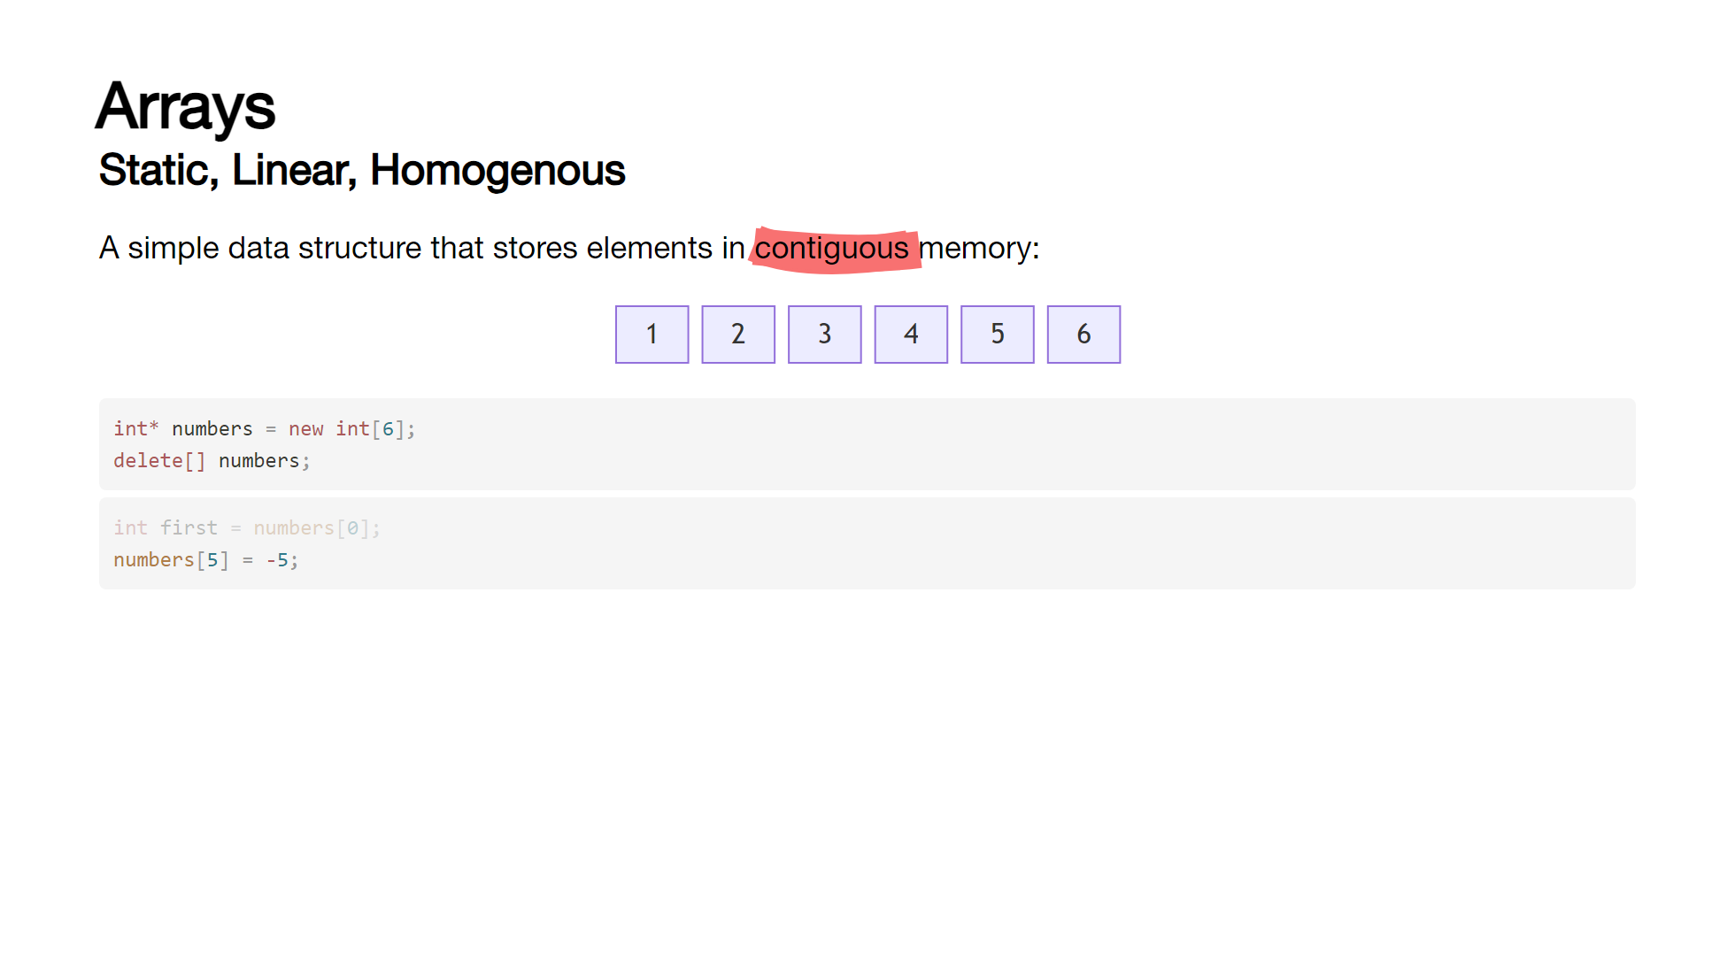
Notes:
Arrays are probably the most basic form of data structure we will look at. [click] They are linear, static and homogeneous - [click] storing memory in contiguous memory. [click] When we instantiate an array in C++, the compiler allocates the space necessary as one block, based on the size of the specified type and the fixed size of the array. [click] So to create an array of integers, we do this - here we're also providing a set of values to fill the array with [click] when we specify elements at compile-time, we do not need to specify a size. [click] If we do specify a size and offer up fewer elements, the remaining elements will be set to zero (or the default value for the type). [click] we can also use the std::array template class, which is a bit more modern and offers some additional functionality. [click] If we really, really need an array allocated at runtime, then we need to dynamically allocate it using the new[] operator [click] and then remember to delete that array once we're done with it. [click] Arrays are zero-indexed, so to get the first element we use index 0 [click] to get the last, array size - 1. [click] If we try and access an array with a value below 0 or above the array size - 1, we are out of bounds which can cause all sorts of issues, the best of which is a straight crash.

Slide 18
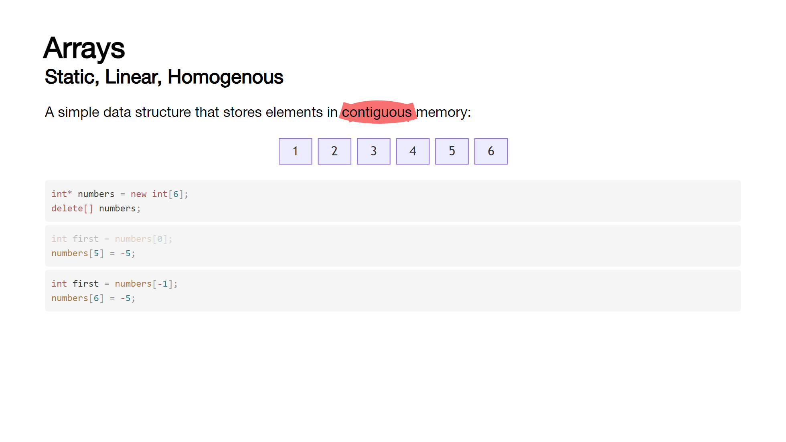
Notes:
Arrays are probably the most basic form of data structure we will look at. [click] They are linear, static and homogeneous - [click] storing memory in contiguous memory. [click] When we instantiate an array in C++, the compiler allocates the space necessary as one block, based on the size of the specified type and the fixed size of the array. [click] So to create an array of integers, we do this - here we're also providing a set of values to fill the array with [click] when we specify elements at compile-time, we do not need to specify a size. [click] If we do specify a size and offer up fewer elements, the remaining elements will be set to zero (or the default value for the type). [click] we can also use the std::array template class, which is a bit more modern and offers some additional functionality. [click] If we really, really need an array allocated at runtime, then we need to dynamically allocate it using the new[] operator [click] and then remember to delete that array once we're done with it. [click] Arrays are zero-indexed, so to get the first element we use index 0 [click] to get the last, array size - 1. [click] If we try and access an array with a value below 0 or above the array size - 1, we are out of bounds which can cause all sorts of issues, the best of which is a straight crash.

Slide 19
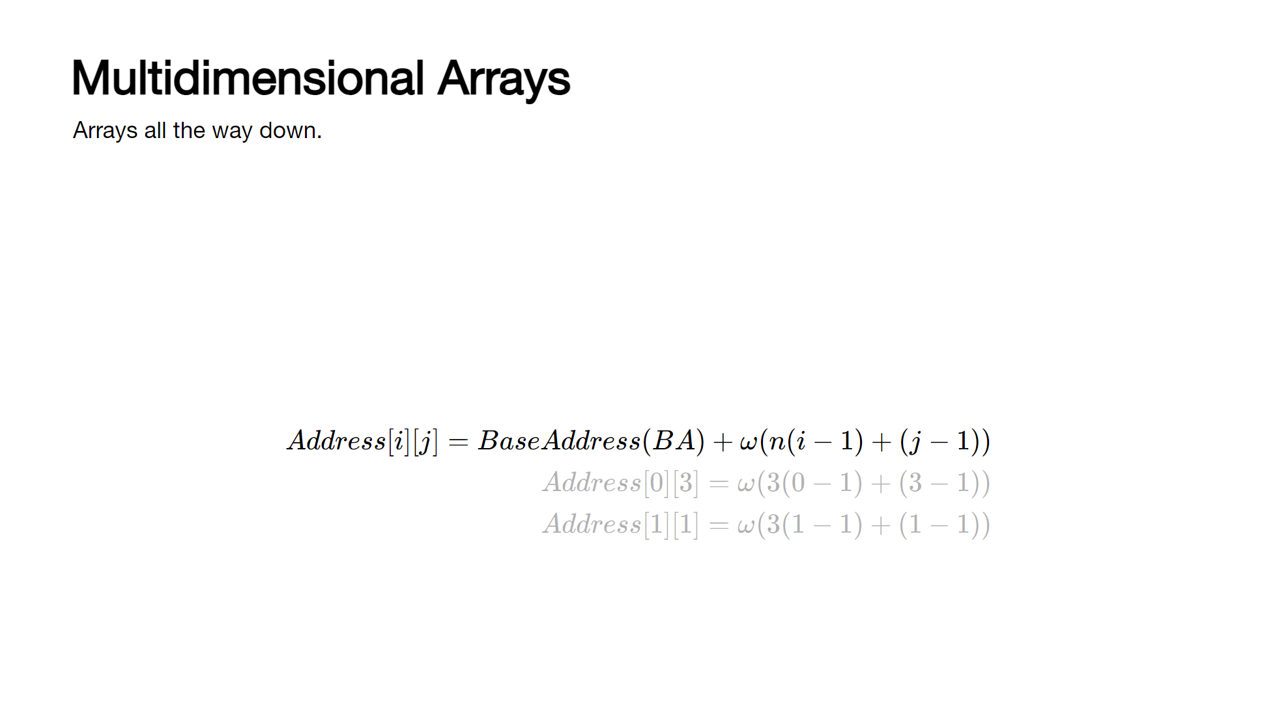
Notes:
Arrays can store arrays, which themselves can store arrays - though much beyond 2 or 3 dimensional arrays are rarely used in "day to day" coding. [click] We can instantiate a dimensional array by specifying a further set of array sizes in square brackets. [click] Each dimension does not need to be the same size allowing us to have "ragged" arrays. [click] As with 1d arrays, we can initialize them on construction [click] or via a loop later in the code base. [click] accessing elements is the same as single dimensional arrays - they are referenced in row-major order. [click] accessing out of bounds in a multidimensional array can have unexpected consequences - here, [0][3] modifies the element at [1][1]... [click] This happens because of how the array is stored in memory and how the indices represent an offset from the start of the memory allocation. We can calculate the memory location for any given combination of indices using this formula, where Base Address is the specific memory location for the start of the array, w is the size of the stored type in bytes and n is the number of rows in the array. [click]

Slide 20
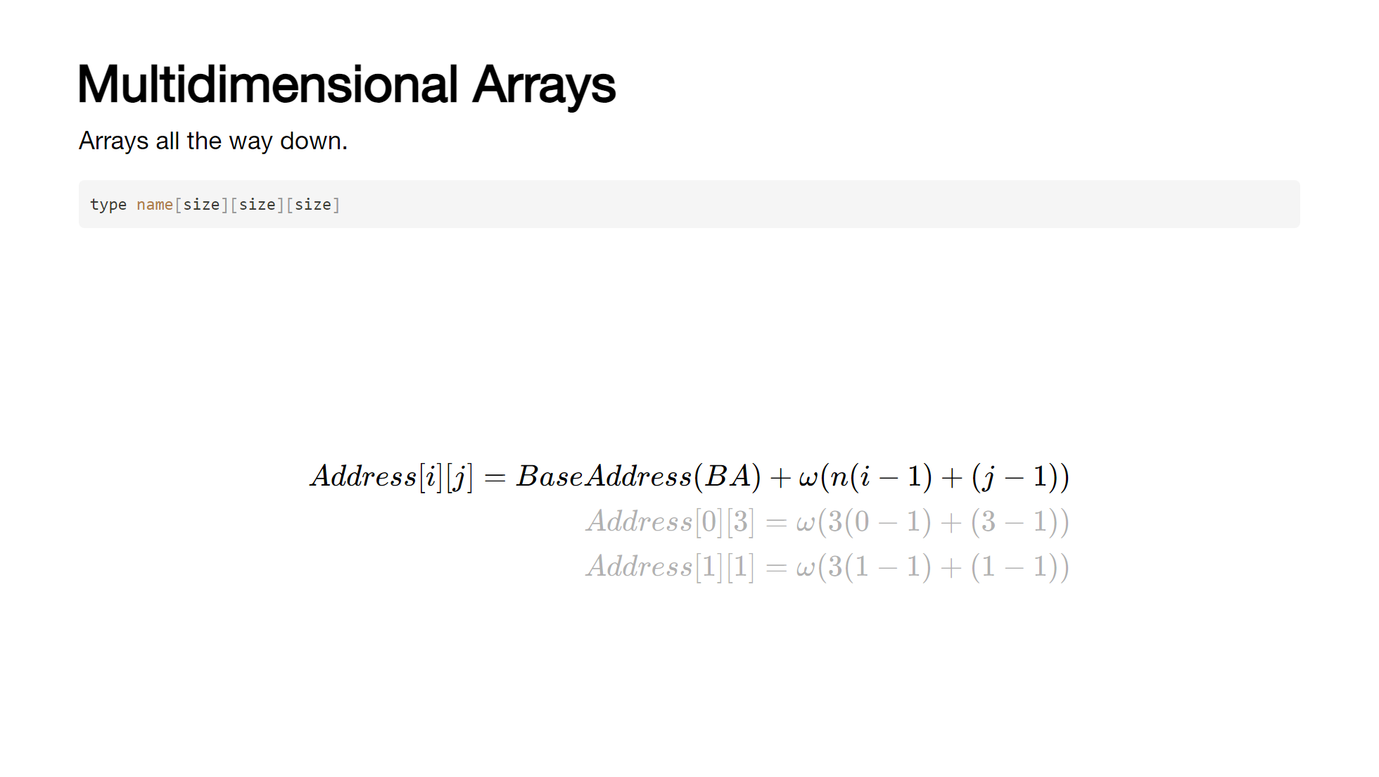
Notes:
Arrays can store arrays, which themselves can store arrays - though much beyond 2 or 3 dimensional arrays are rarely used in "day to day" coding. [click] We can instantiate a dimensional array by specifying a further set of array sizes in square brackets. [click] Each dimension does not need to be the same size allowing us to have "ragged" arrays. [click] As with 1d arrays, we can initialize them on construction [click] or via a loop later in the code base. [click] accessing elements is the same as single dimensional arrays - they are referenced in row-major order. [click] accessing out of bounds in a multidimensional array can have unexpected consequences - here, [0][3] modifies the element at [1][1]... [click] This happens because of how the array is stored in memory and how the indices represent an offset from the start of the memory allocation. We can calculate the memory location for any given combination of indices using this formula, where Base Address is the specific memory location for the start of the array, w is the size of the stored type in bytes and n is the number of rows in the array. [click]

Slide 21

Notes:
Arrays can store arrays, which themselves can store arrays - though much beyond 2 or 3 dimensional arrays are rarely used in "day to day" coding. [click] We can instantiate a dimensional array by specifying a further set of array sizes in square brackets. [click] Each dimension does not need to be the same size allowing us to have "ragged" arrays. [click] As with 1d arrays, we can initialize them on construction [click] or via a loop later in the code base. [click] accessing elements is the same as single dimensional arrays - they are referenced in row-major order. [click] accessing out of bounds in a multidimensional array can have unexpected consequences - here, [0][3] modifies the element at [1][1]... [click] This happens because of how the array is stored in memory and how the indices represent an offset from the start of the memory allocation. We can calculate the memory location for any given combination of indices using this formula, where Base Address is the specific memory location for the start of the array, w is the size of the stored type in bytes and n is the number of rows in the array. [click]

Slide 22
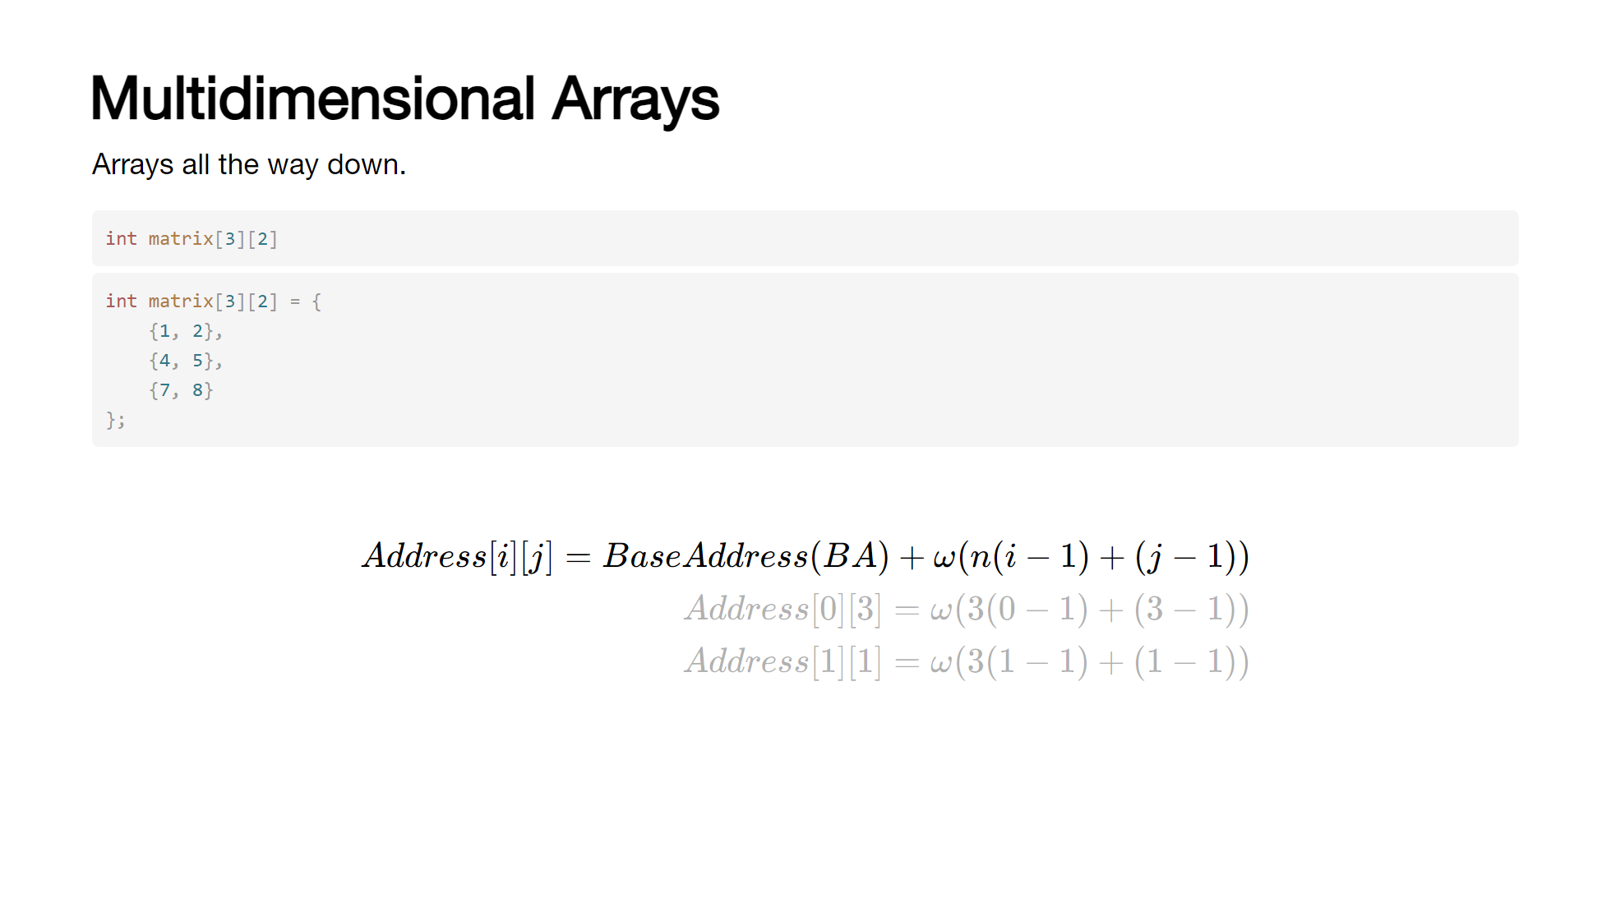
Notes:
Arrays can store arrays, which themselves can store arrays - though much beyond 2 or 3 dimensional arrays are rarely used in "day to day" coding. [click] We can instantiate a dimensional array by specifying a further set of array sizes in square brackets. [click] Each dimension does not need to be the same size allowing us to have "ragged" arrays. [click] As with 1d arrays, we can initialize them on construction [click] or via a loop later in the code base. [click] accessing elements is the same as single dimensional arrays - they are referenced in row-major order. [click] accessing out of bounds in a multidimensional array can have unexpected consequences - here, [0][3] modifies the element at [1][1]... [click] This happens because of how the array is stored in memory and how the indices represent an offset from the start of the memory allocation. We can calculate the memory location for any given combination of indices using this formula, where Base Address is the specific memory location for the start of the array, w is the size of the stored type in bytes and n is the number of rows in the array. [click]

Slide 23
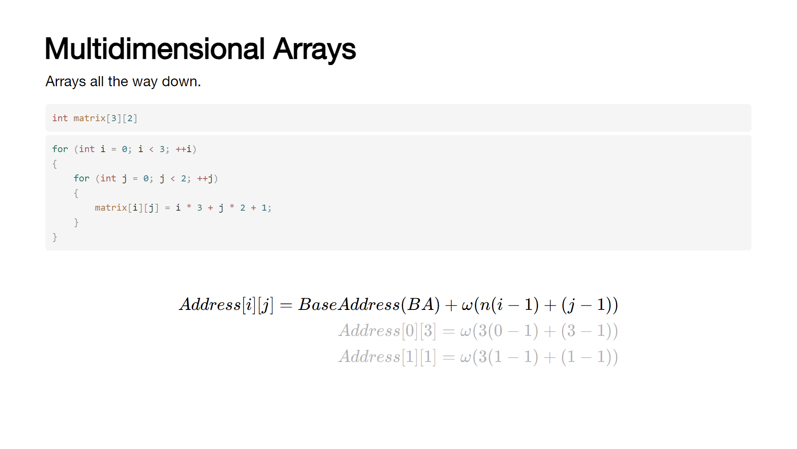
Notes:
Arrays can store arrays, which themselves can store arrays - though much beyond 2 or 3 dimensional arrays are rarely used in "day to day" coding. [click] We can instantiate a dimensional array by specifying a further set of array sizes in square brackets. [click] Each dimension does not need to be the same size allowing us to have "ragged" arrays. [click] As with 1d arrays, we can initialize them on construction [click] or via a loop later in the code base. [click] accessing elements is the same as single dimensional arrays - they are referenced in row-major order. [click] accessing out of bounds in a multidimensional array can have unexpected consequences - here, [0][3] modifies the element at [1][1]... [click] This happens because of how the array is stored in memory and how the indices represent an offset from the start of the memory allocation. We can calculate the memory location for any given combination of indices using this formula, where Base Address is the specific memory location for the start of the array, w is the size of the stored type in bytes and n is the number of rows in the array. [click]

Slide 24
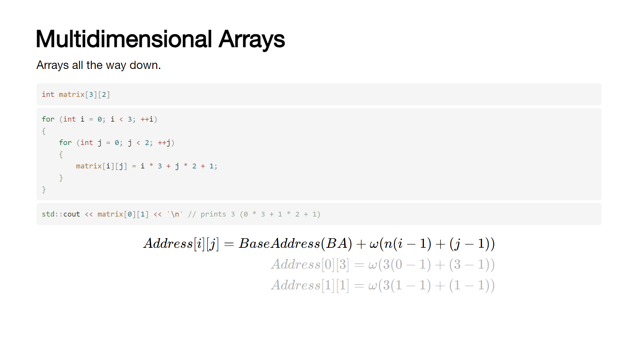
Notes:
Arrays can store arrays, which themselves can store arrays - though much beyond 2 or 3 dimensional arrays are rarely used in "day to day" coding. [click] We can instantiate a dimensional array by specifying a further set of array sizes in square brackets. [click] Each dimension does not need to be the same size allowing us to have "ragged" arrays. [click] As with 1d arrays, we can initialize them on construction [click] or via a loop later in the code base. [click] accessing elements is the same as single dimensional arrays - they are referenced in row-major order. [click] accessing out of bounds in a multidimensional array can have unexpected consequences - here, [0][3] modifies the element at [1][1]... [click] This happens because of how the array is stored in memory and how the indices represent an offset from the start of the memory allocation. We can calculate the memory location for any given combination of indices using this formula, where Base Address is the specific memory location for the start of the array, w is the size of the stored type in bytes and n is the number of rows in the array. [click]

Slide 25
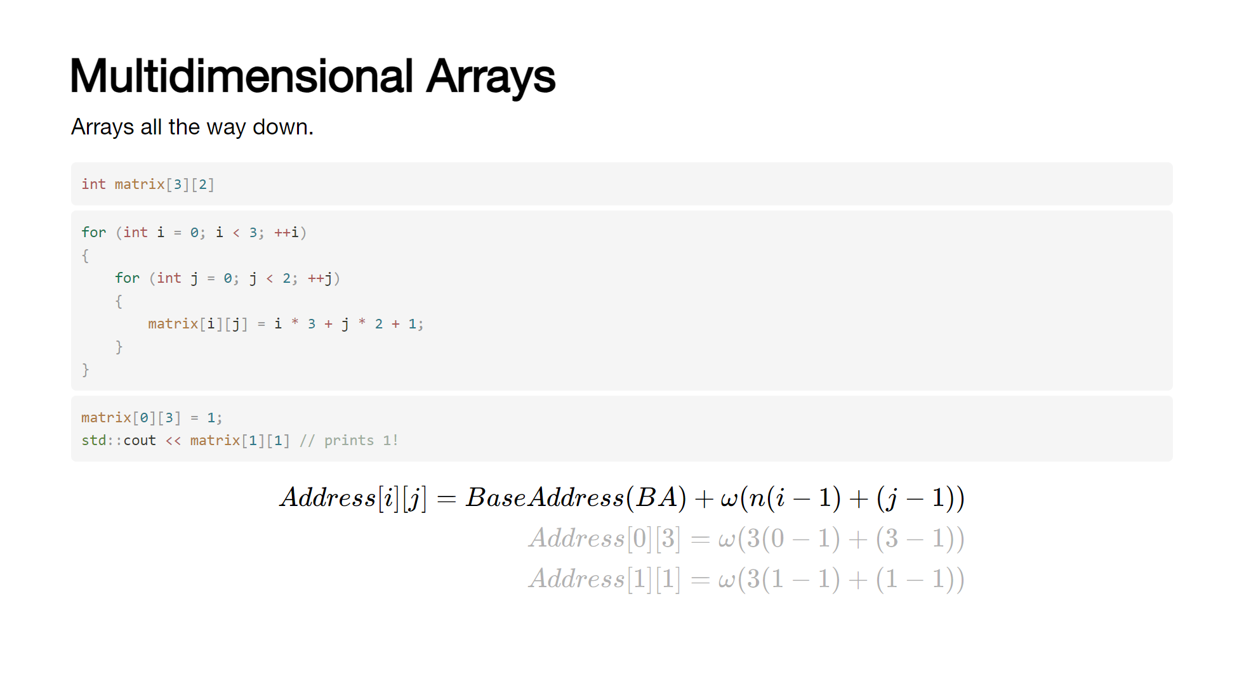
Notes:
Arrays can store arrays, which themselves can store arrays - though much beyond 2 or 3 dimensional arrays are rarely used in "day to day" coding. [click] We can instantiate a dimensional array by specifying a further set of array sizes in square brackets. [click] Each dimension does not need to be the same size allowing us to have "ragged" arrays. [click] As with 1d arrays, we can initialize them on construction [click] or via a loop later in the code base. [click] accessing elements is the same as single dimensional arrays - they are referenced in row-major order. [click] accessing out of bounds in a multidimensional array can have unexpected consequences - here, [0][3] modifies the element at [1][1]... [click] This happens because of how the array is stored in memory and how the indices represent an offset from the start of the memory allocation. We can calculate the memory location for any given combination of indices using this formula, where Base Address is the specific memory location for the start of the array, w is the size of the stored type in bytes and n is the number of rows in the array. [click]

Slide 26
Notes:
Arrays can store arrays, which themselves can store arrays - though much beyond 2 or 3 dimensional arrays are rarely used in "day to day" coding. [click] We can instantiate a dimensional array by specifying a further set of array sizes in square brackets. [click] Each dimension does not need to be the same size allowing us to have "ragged" arrays. [click] As with 1d arrays, we can initialize them on construction [click] or via a loop later in the code base. [click] accessing elements is the same as single dimensional arrays - they are referenced in row-major order. [click] accessing out of bounds in a multidimensional array can have unexpected consequences - here, [0][3] modifies the element at [1][1]... [click] This happens because of how the array is stored in memory and how the indices represent an offset from the start of the memory allocation. We can calculate the memory location for any given combination of indices using this formula, where Base Address is the specific memory location for the start of the array, w is the size of the stored type in bytes and n is the number of rows in the array. [click]

Slide 27
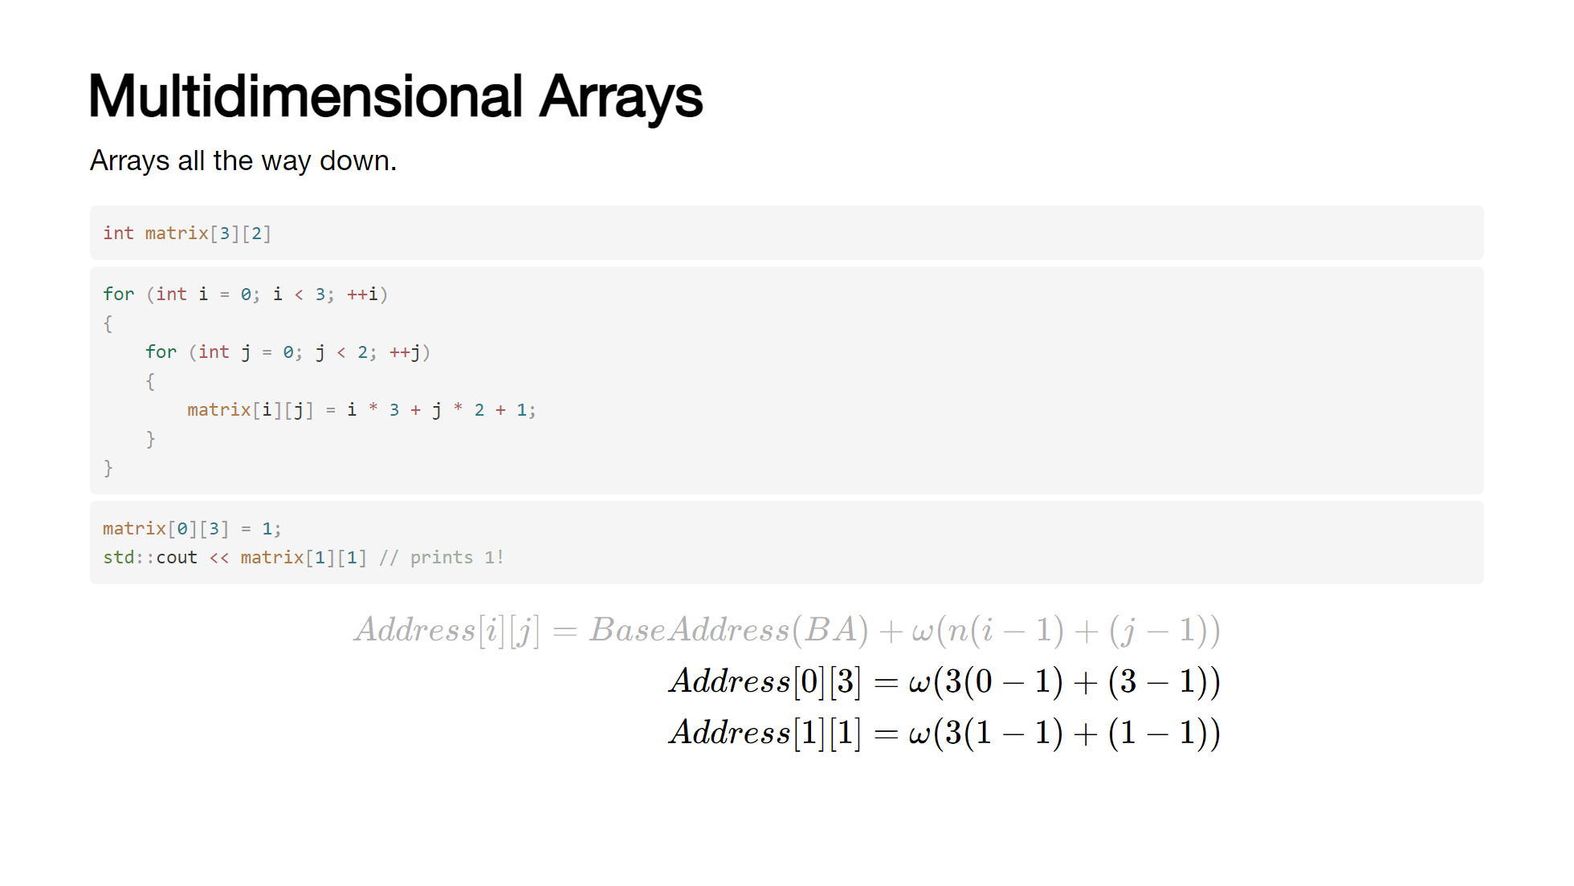
Notes:
Arrays can store arrays, which themselves can store arrays - though much beyond 2 or 3 dimensional arrays are rarely used in "day to day" coding. [click] We can instantiate a dimensional array by specifying a further set of array sizes in square brackets. [click] Each dimension does not need to be the same size allowing us to have "ragged" arrays. [click] As with 1d arrays, we can initialize them on construction [click] or via a loop later in the code base. [click] accessing elements is the same as single dimensional arrays - they are referenced in row-major order. [click] accessing out of bounds in a multidimensional array can have unexpected consequences - here, [0][3] modifies the element at [1][1]... [click] This happens because of how the array is stored in memory and how the indices represent an offset from the start of the memory allocation. We can calculate the memory location for any given combination of indices using this formula, where Base Address is the specific memory location for the start of the array, w is the size of the stored type in bytes and n is the number of rows in the array. [click]

Slide 28
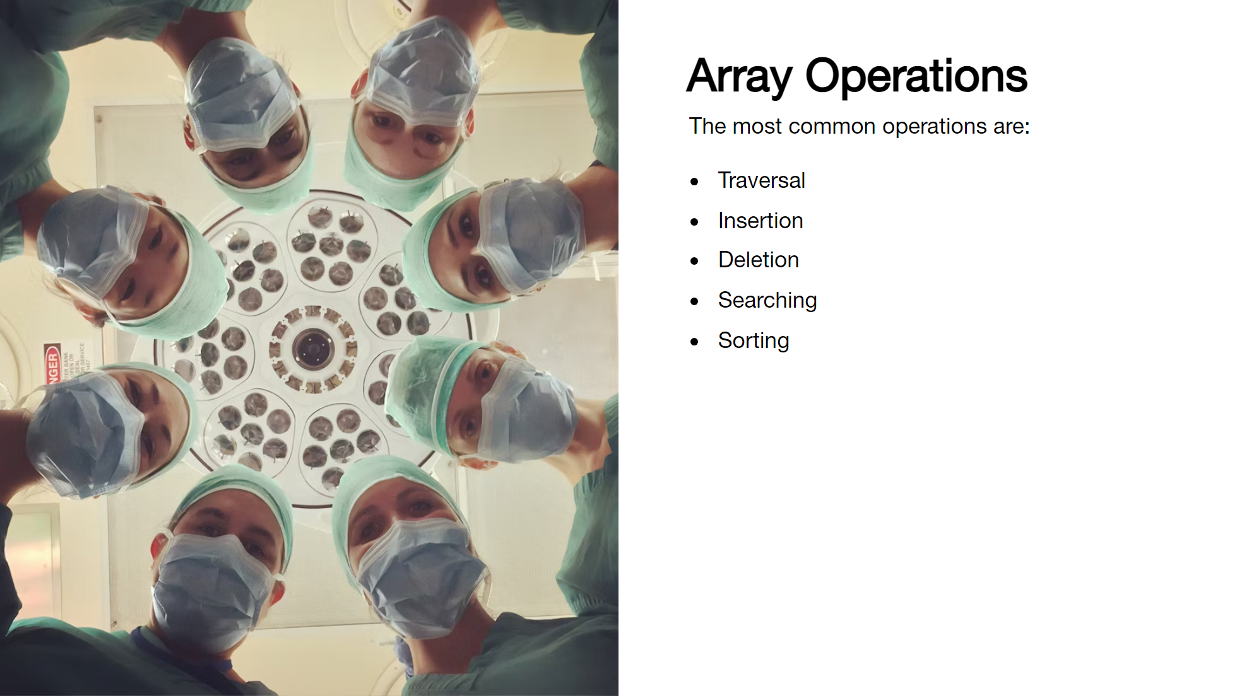

Slide 29
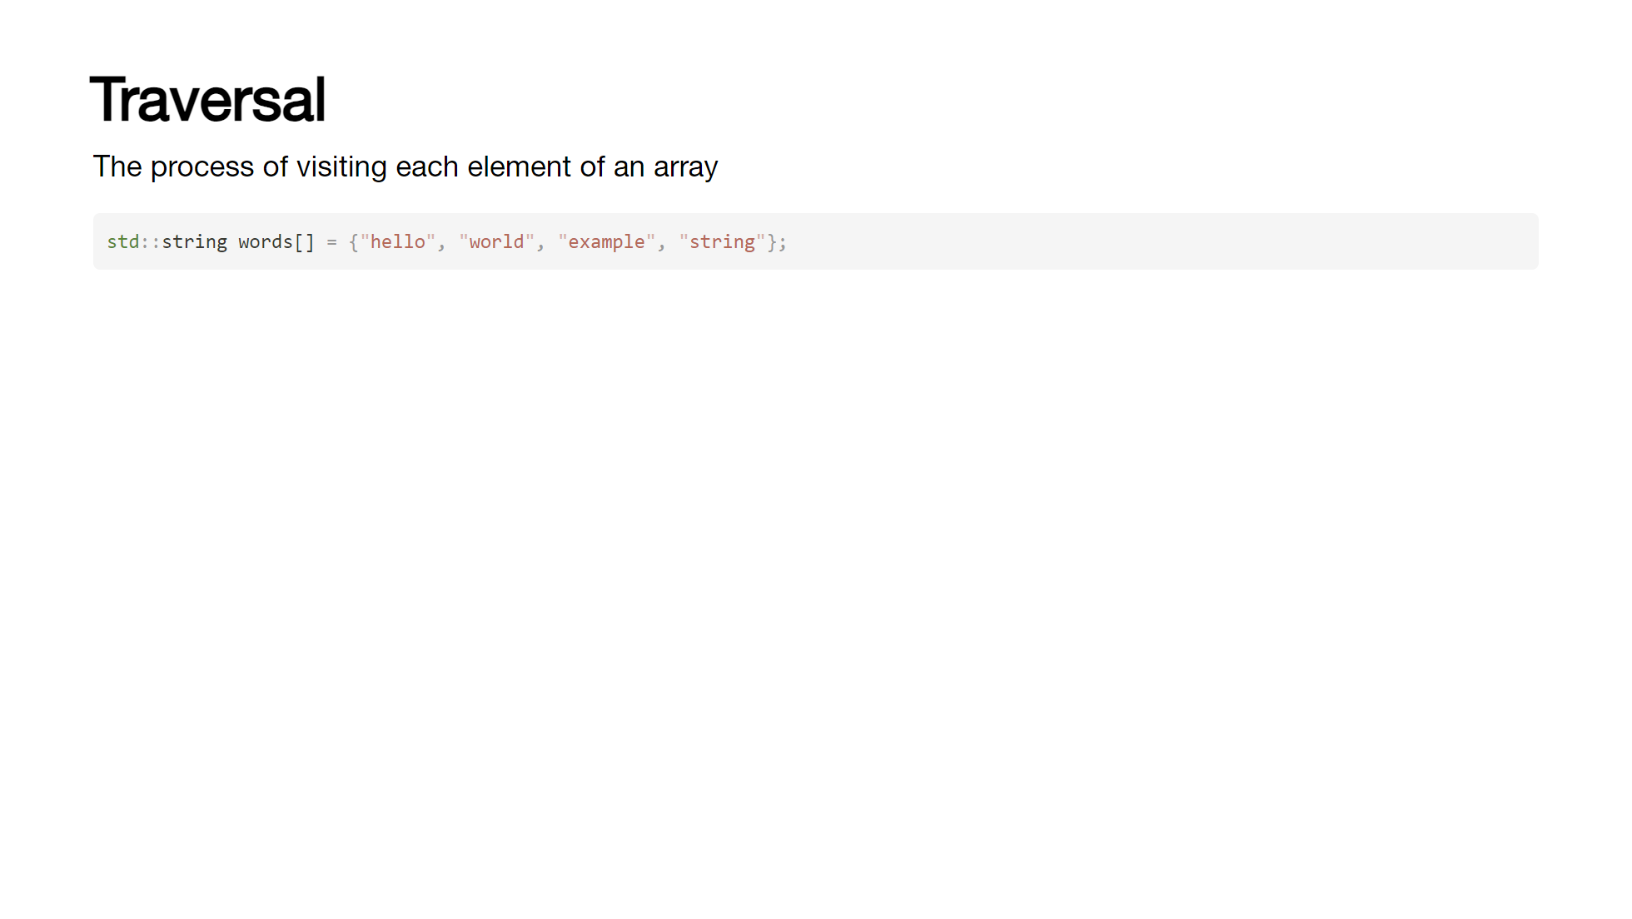
Notes:
In most programming languages, this is achieved by iterating over the array, one element at a time - either from front to back or vice versa. There are quite a few reasons we might want to do this; performing a calculation on each element, filtering out elements that meet a certain criteria, or just printing them out. If the array holds advanced data structures or objects, we might want to call a method on each element. [click] Here we have an array of strings, and we want to capitalize the first letter of each word. [click] We can do this by iterating over the array and then accessing each element in turn. [click] We can then check if the element is empty and if not, capitalize the first letter. [click] By starting at the end of the array, we can also traverse it in reverse.

Slide 30

Notes:
In most programming languages, this is achieved by iterating over the array, one element at a time - either from front to back or vice versa. There are quite a few reasons we might want to do this; performing a calculation on each element, filtering out elements that meet a certain criteria, or just printing them out. If the array holds advanced data structures or objects, we might want to call a method on each element. [click] Here we have an array of strings, and we want to capitalize the first letter of each word. [click] We can do this by iterating over the array and then accessing each element in turn. [click] We can then check if the element is empty and if not, capitalize the first letter. [click] By starting at the end of the array, we can also traverse it in reverse.

Slide 31
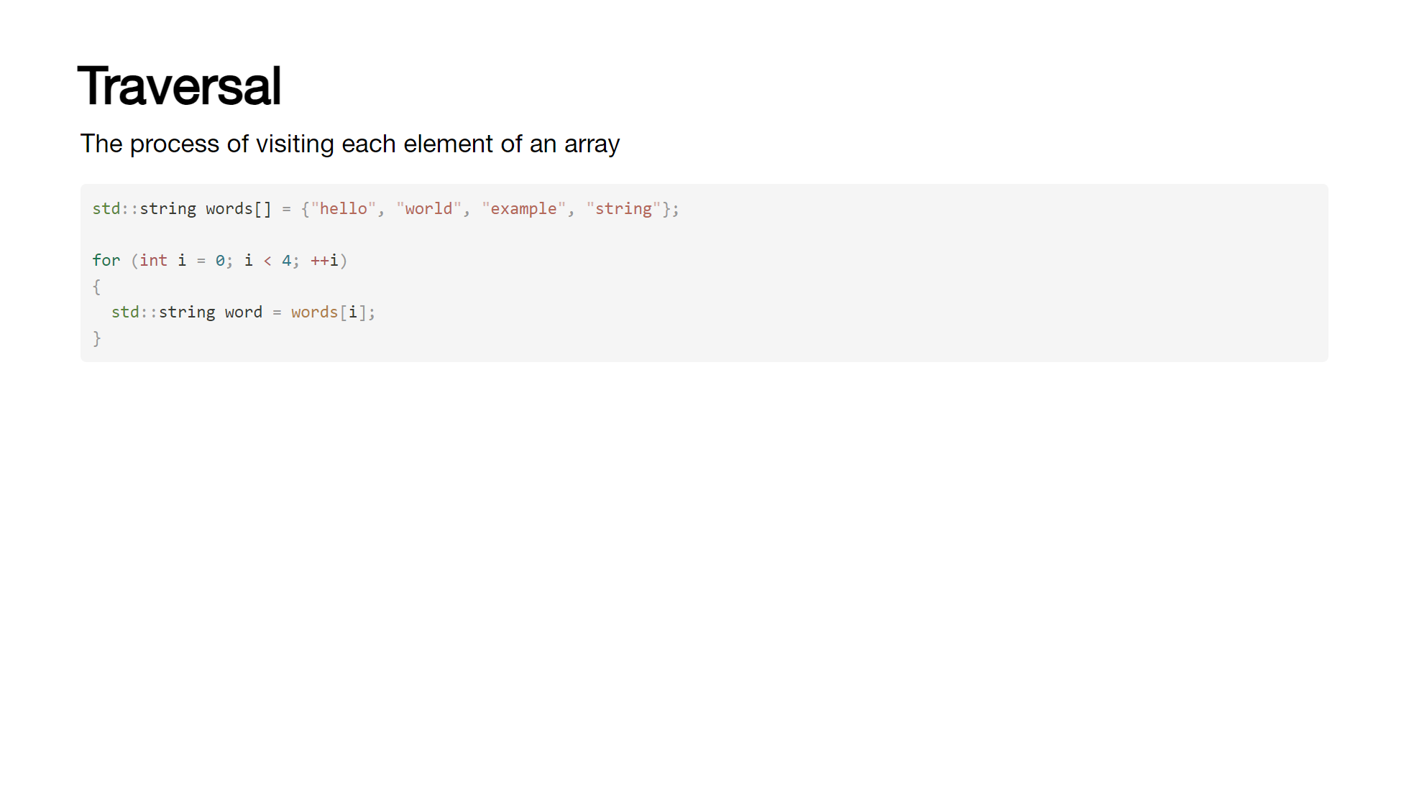
Notes:
In most programming languages, this is achieved by iterating over the array, one element at a time - either from front to back or vice versa. There are quite a few reasons we might want to do this; performing a calculation on each element, filtering out elements that meet a certain criteria, or just printing them out. If the array holds advanced data structures or objects, we might want to call a method on each element. [click] Here we have an array of strings, and we want to capitalize the first letter of each word. [click] We can do this by iterating over the array and then accessing each element in turn. [click] We can then check if the element is empty and if not, capitalize the first letter. [click] By starting at the end of the array, we can also traverse it in reverse.

Slide 32
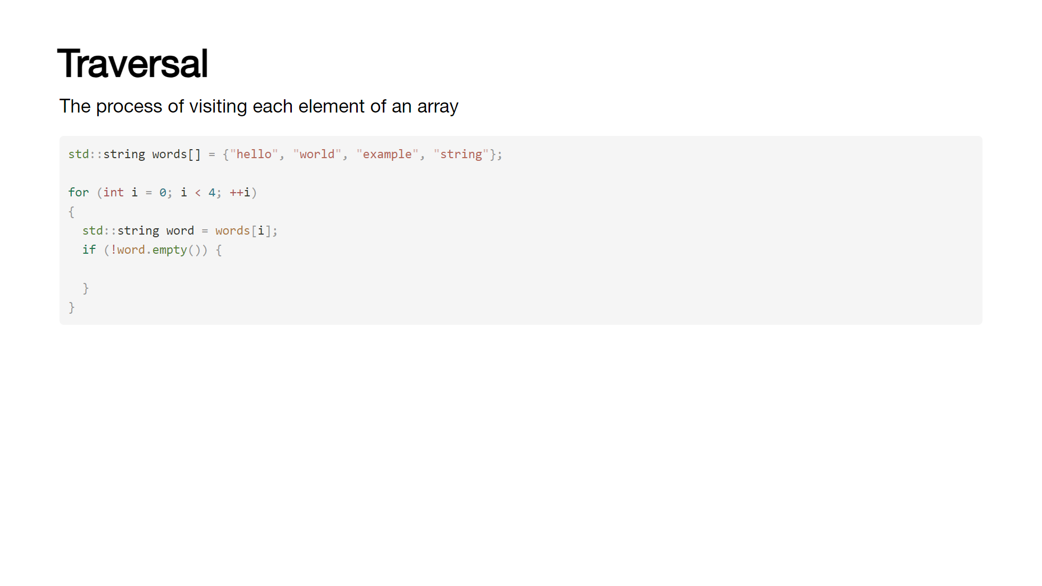
Notes:
In most programming languages, this is achieved by iterating over the array, one element at a time - either from front to back or vice versa. There are quite a few reasons we might want to do this; performing a calculation on each element, filtering out elements that meet a certain criteria, or just printing them out. If the array holds advanced data structures or objects, we might want to call a method on each element. [click] Here we have an array of strings, and we want to capitalize the first letter of each word. [click] We can do this by iterating over the array and then accessing each element in turn. [click] We can then check if the element is empty and if not, capitalize the first letter. [click] By starting at the end of the array, we can also traverse it in reverse.

Slide 33
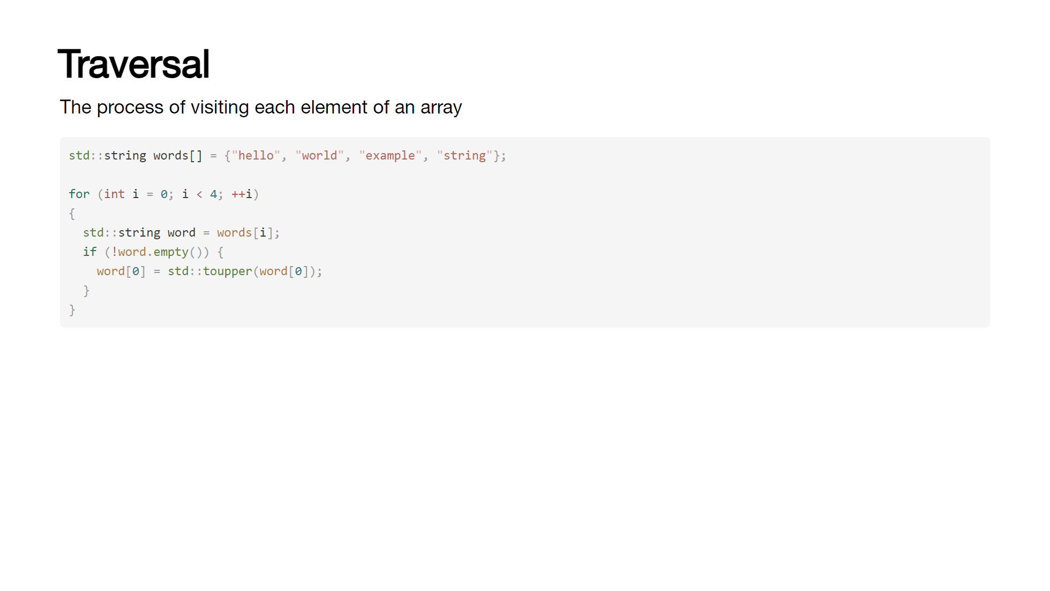
Notes:
In most programming languages, this is achieved by iterating over the array, one element at a time - either from front to back or vice versa. There are quite a few reasons we might want to do this; performing a calculation on each element, filtering out elements that meet a certain criteria, or just printing them out. If the array holds advanced data structures or objects, we might want to call a method on each element. [click] Here we have an array of strings, and we want to capitalize the first letter of each word. [click] We can do this by iterating over the array and then accessing each element in turn. [click] We can then check if the element is empty and if not, capitalize the first letter. [click] By starting at the end of the array, we can also traverse it in reverse.

Slide 34
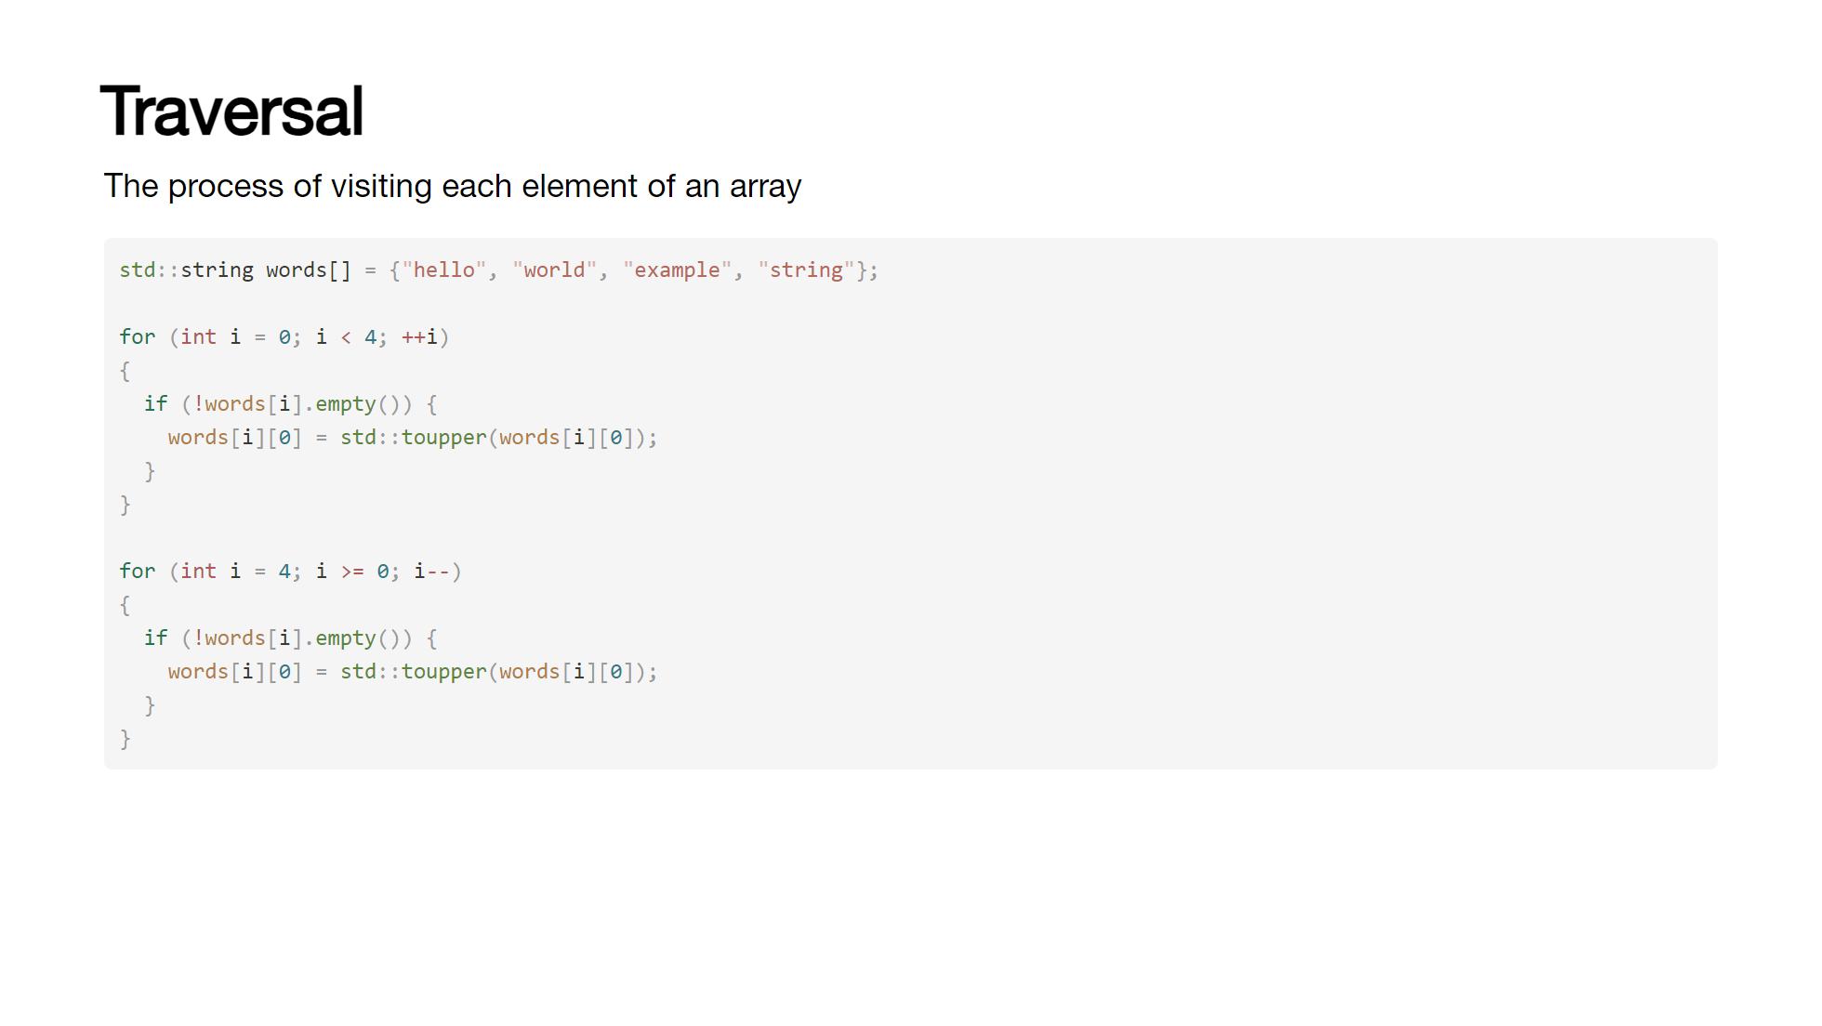
Notes:
In most programming languages, this is achieved by iterating over the array, one element at a time - either from front to back or vice versa. There are quite a few reasons we might want to do this; performing a calculation on each element, filtering out elements that meet a certain criteria, or just printing them out. If the array holds advanced data structures or objects, we might want to call a method on each element. [click] Here we have an array of strings, and we want to capitalize the first letter of each word. [click] We can do this by iterating over the array and then accessing each element in turn. [click] We can then check if the element is empty and if not, capitalize the first letter. [click] By starting at the end of the array, we can also traverse it in reverse.

Slide 35
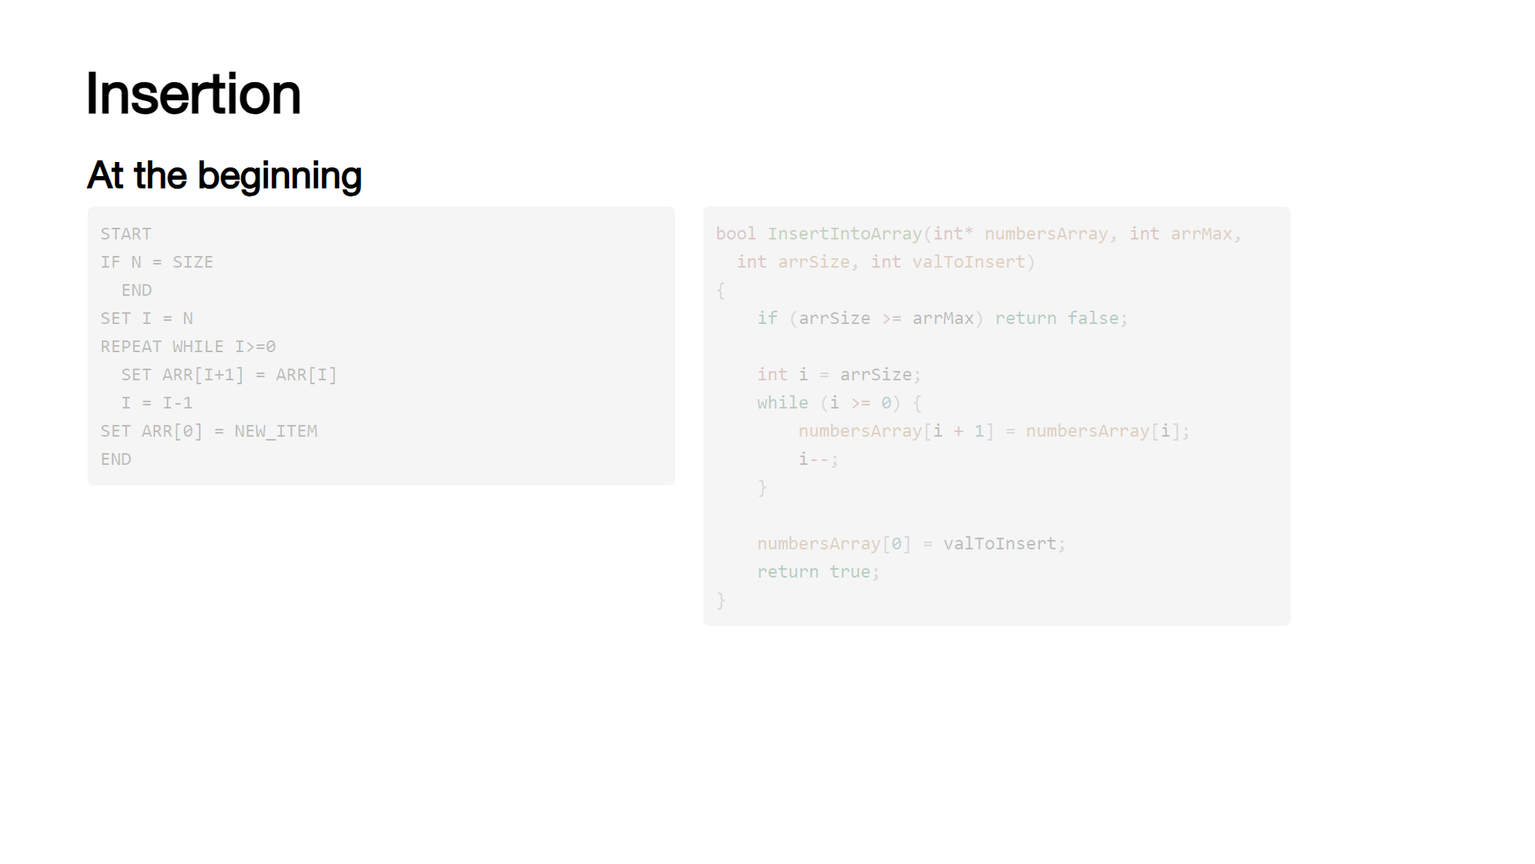
Notes:
Due to the fixed size nature of arrays, inserting an element without overwriting existing data requires some work. There are three places we can insert; at the beginning, at a specific point and at the end. [click] For insertion at the beginning, we have to move all existing elements along one slot in the array - [click] the algorithm for which looks something like this: [click] we cannot insert anything if the array is full - N is the number of existing elements and SIZE is the max size of the array. [click] we start at the end of the array - so we set I to the value of N [click] then we iterate while I is greater to or equal to 0, each iteration we set copy the current element to the position one "behind" where we are and I is decremented [click] once I is equal to 0, we're at the start of the array and can insert the new element at the first index [click] inserting at a specific position is the same, we move the elements back until we reach the desired position and then we set the element to the new value. [click] while inserting at the end is very straightforward, we just set the element to the new value.

Slide 36
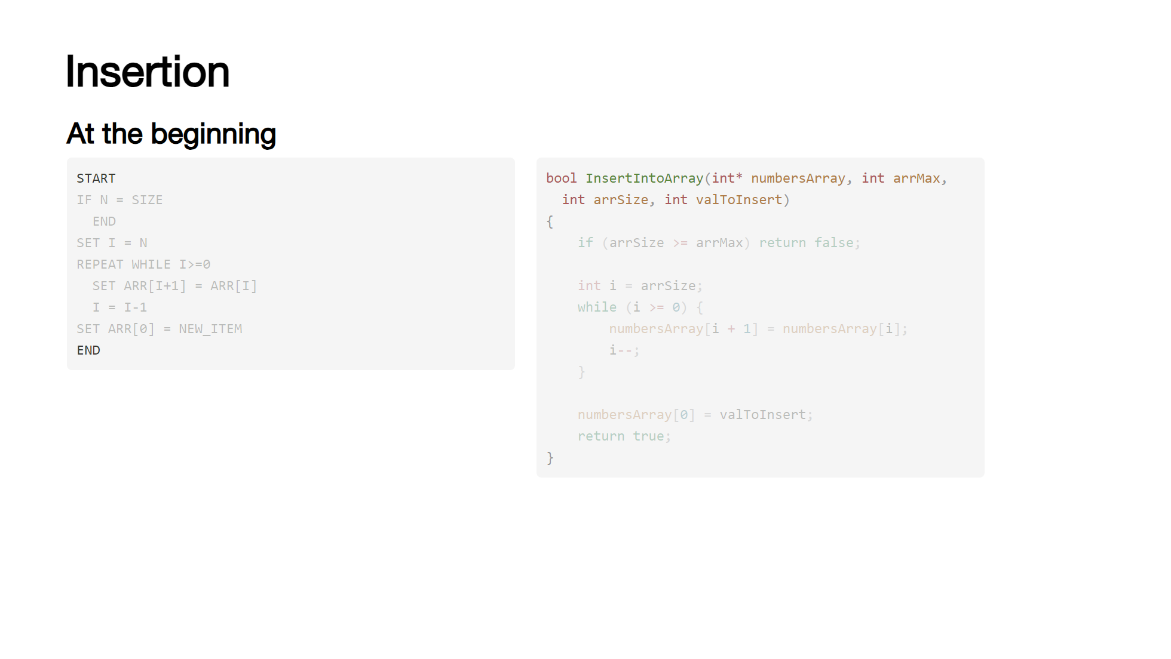
Notes:
Due to the fixed size nature of arrays, inserting an element without overwriting existing data requires some work. There are three places we can insert; at the beginning, at a specific point and at the end. [click] For insertion at the beginning, we have to move all existing elements along one slot in the array - [click] the algorithm for which looks something like this: [click] we cannot insert anything if the array is full - N is the number of existing elements and SIZE is the max size of the array. [click] we start at the end of the array - so we set I to the value of N [click] then we iterate while I is greater to or equal to 0, each iteration we set copy the current element to the position one "behind" where we are and I is decremented [click] once I is equal to 0, we're at the start of the array and can insert the new element at the first index [click] inserting at a specific position is the same, we move the elements back until we reach the desired position and then we set the element to the new value. [click] while inserting at the end is very straightforward, we just set the element to the new value.

Slide 37
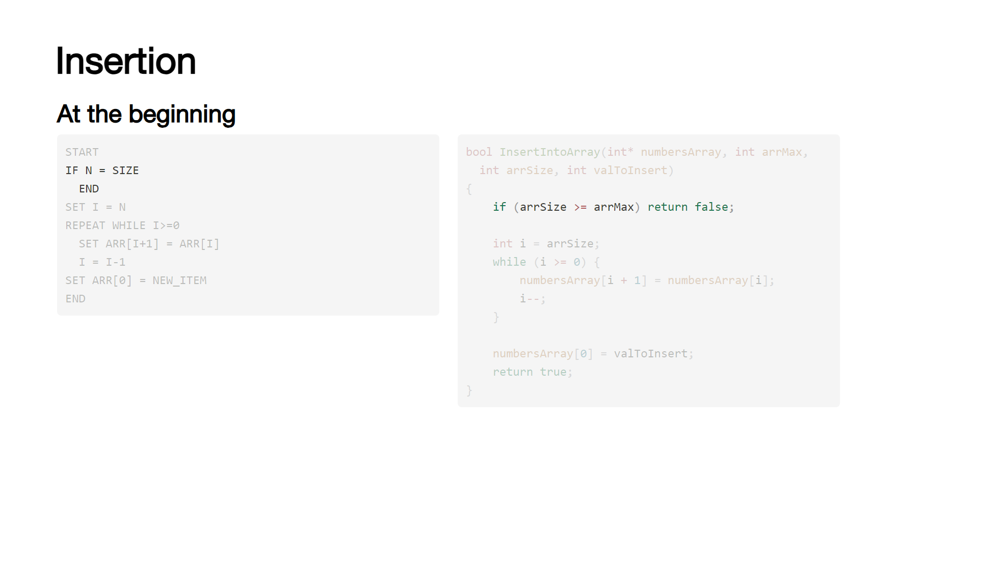
Notes:
Due to the fixed size nature of arrays, inserting an element without overwriting existing data requires some work. There are three places we can insert; at the beginning, at a specific point and at the end. [click] For insertion at the beginning, we have to move all existing elements along one slot in the array - [click] the algorithm for which looks something like this: [click] we cannot insert anything if the array is full - N is the number of existing elements and SIZE is the max size of the array. [click] we start at the end of the array - so we set I to the value of N [click] then we iterate while I is greater to or equal to 0, each iteration we set copy the current element to the position one "behind" where we are and I is decremented [click] once I is equal to 0, we're at the start of the array and can insert the new element at the first index [click] inserting at a specific position is the same, we move the elements back until we reach the desired position and then we set the element to the new value. [click] while inserting at the end is very straightforward, we just set the element to the new value.

Slide 38

Notes:
Due to the fixed size nature of arrays, inserting an element without overwriting existing data requires some work. There are three places we can insert; at the beginning, at a specific point and at the end. [click] For insertion at the beginning, we have to move all existing elements along one slot in the array - [click] the algorithm for which looks something like this: [click] we cannot insert anything if the array is full - N is the number of existing elements and SIZE is the max size of the array. [click] we start at the end of the array - so we set I to the value of N [click] then we iterate while I is greater to or equal to 0, each iteration we set copy the current element to the position one "behind" where we are and I is decremented [click] once I is equal to 0, we're at the start of the array and can insert the new element at the first index [click] inserting at a specific position is the same, we move the elements back until we reach the desired position and then we set the element to the new value. [click] while inserting at the end is very straightforward, we just set the element to the new value.

Slide 39
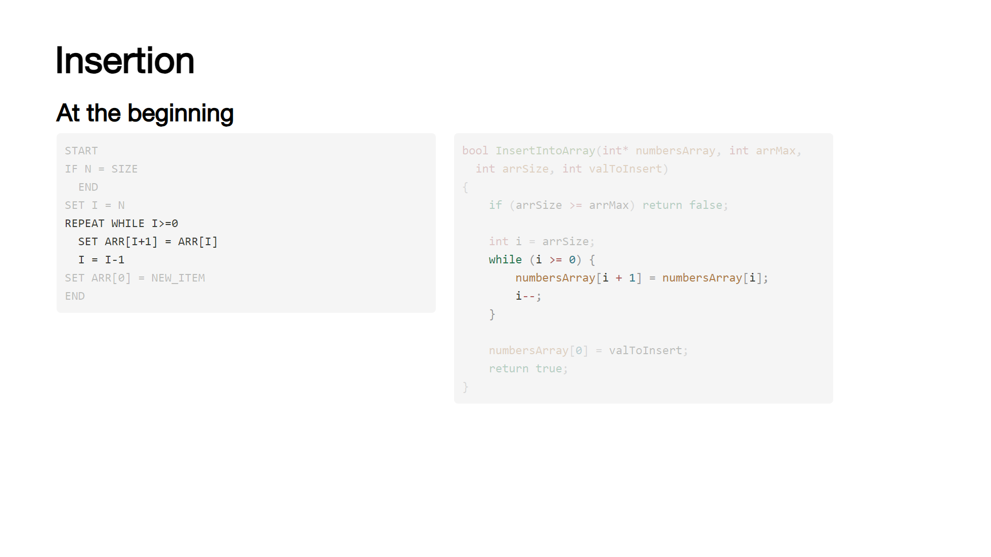
Notes:
Due to the fixed size nature of arrays, inserting an element without overwriting existing data requires some work. There are three places we can insert; at the beginning, at a specific point and at the end. [click] For insertion at the beginning, we have to move all existing elements along one slot in the array - [click] the algorithm for which looks something like this: [click] we cannot insert anything if the array is full - N is the number of existing elements and SIZE is the max size of the array. [click] we start at the end of the array - so we set I to the value of N [click] then we iterate while I is greater to or equal to 0, each iteration we set copy the current element to the position one "behind" where we are and I is decremented [click] once I is equal to 0, we're at the start of the array and can insert the new element at the first index [click] inserting at a specific position is the same, we move the elements back until we reach the desired position and then we set the element to the new value. [click] while inserting at the end is very straightforward, we just set the element to the new value.

Slide 40
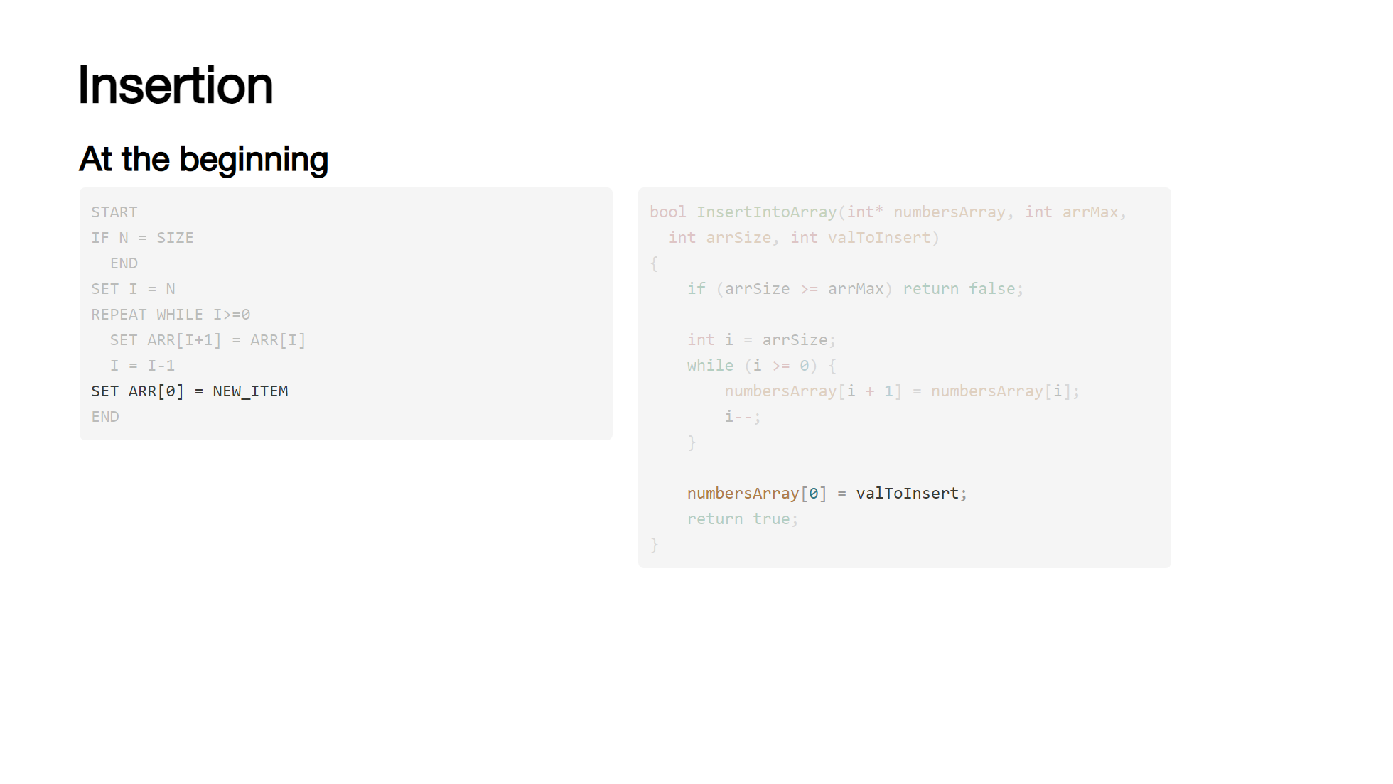
Notes:
Due to the fixed size nature of arrays, inserting an element without overwriting existing data requires some work. There are three places we can insert; at the beginning, at a specific point and at the end. [click] For insertion at the beginning, we have to move all existing elements along one slot in the array - [click] the algorithm for which looks something like this: [click] we cannot insert anything if the array is full - N is the number of existing elements and SIZE is the max size of the array. [click] we start at the end of the array - so we set I to the value of N [click] then we iterate while I is greater to or equal to 0, each iteration we set copy the current element to the position one "behind" where we are and I is decremented [click] once I is equal to 0, we're at the start of the array and can insert the new element at the first index [click] inserting at a specific position is the same, we move the elements back until we reach the desired position and then we set the element to the new value. [click] while inserting at the end is very straightforward, we just set the element to the new value.

Slide 41
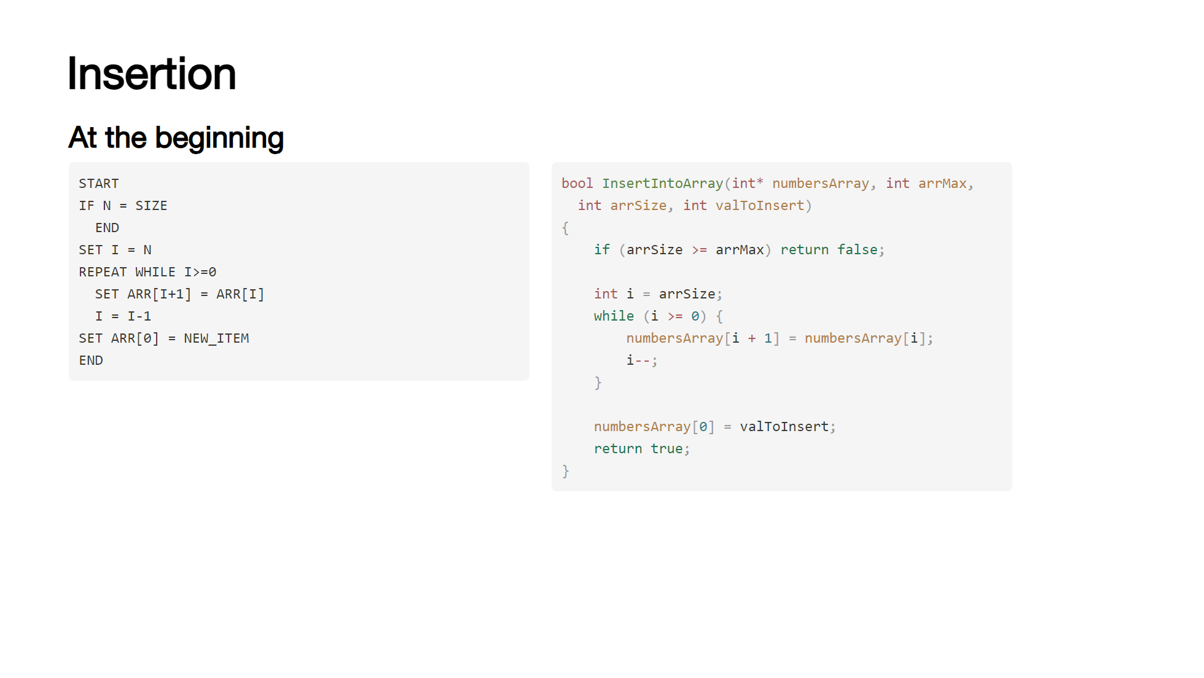
Notes:
Due to the fixed size nature of arrays, inserting an element without overwriting existing data requires some work. There are three places we can insert; at the beginning, at a specific point and at the end. [click] For insertion at the beginning, we have to move all existing elements along one slot in the array - [click] the algorithm for which looks something like this: [click] we cannot insert anything if the array is full - N is the number of existing elements and SIZE is the max size of the array. [click] we start at the end of the array - so we set I to the value of N [click] then we iterate while I is greater to or equal to 0, each iteration we set copy the current element to the position one "behind" where we are and I is decremented [click] once I is equal to 0, we're at the start of the array and can insert the new element at the first index [click] inserting at a specific position is the same, we move the elements back until we reach the desired position and then we set the element to the new value. [click] while inserting at the end is very straightforward, we just set the element to the new value.

Slide 42
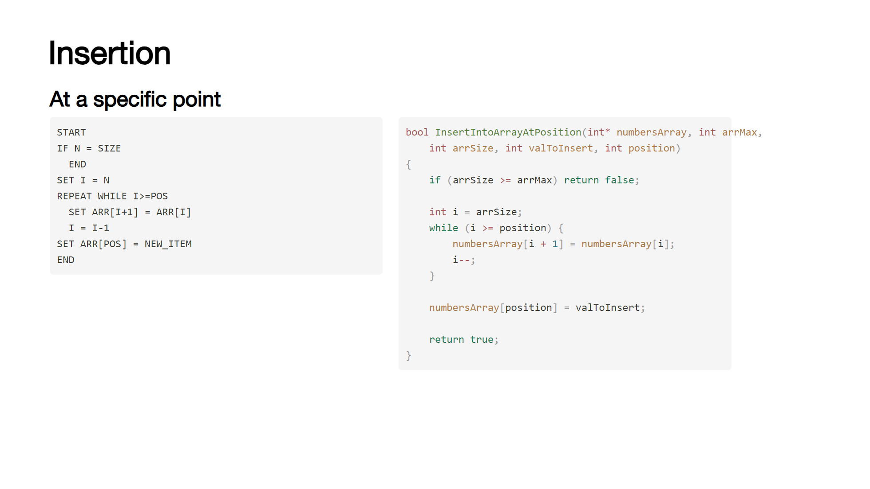
Notes:
Due to the fixed size nature of arrays, inserting an element without overwriting existing data requires some work. There are three places we can insert; at the beginning, at a specific point and at the end. [click] For insertion at the beginning, we have to move all existing elements along one slot in the array - [click] the algorithm for which looks something like this: [click] we cannot insert anything if the array is full - N is the number of existing elements and SIZE is the max size of the array. [click] we start at the end of the array - so we set I to the value of N [click] then we iterate while I is greater to or equal to 0, each iteration we set copy the current element to the position one "behind" where we are and I is decremented [click] once I is equal to 0, we're at the start of the array and can insert the new element at the first index [click] inserting at a specific position is the same, we move the elements back until we reach the desired position and then we set the element to the new value. [click] while inserting at the end is very straightforward, we just set the element to the new value.

Slide 43
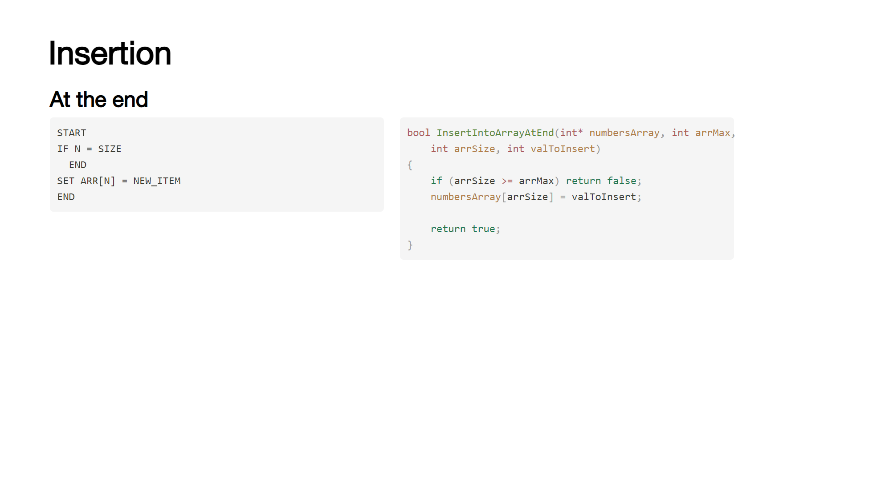
Notes:
Due to the fixed size nature of arrays, inserting an element without overwriting existing data requires some work. There are three places we can insert; at the beginning, at a specific point and at the end. [click] For insertion at the beginning, we have to move all existing elements along one slot in the array - [click] the algorithm for which looks something like this: [click] we cannot insert anything if the array is full - N is the number of existing elements and SIZE is the max size of the array. [click] we start at the end of the array - so we set I to the value of N [click] then we iterate while I is greater to or equal to 0, each iteration we set copy the current element to the position one "behind" where we are and I is decremented [click] once I is equal to 0, we're at the start of the array and can insert the new element at the first index [click] inserting at a specific position is the same, we move the elements back until we reach the desired position and then we set the element to the new value. [click] while inserting at the end is very straightforward, we just set the element to the new value.

Slide 44
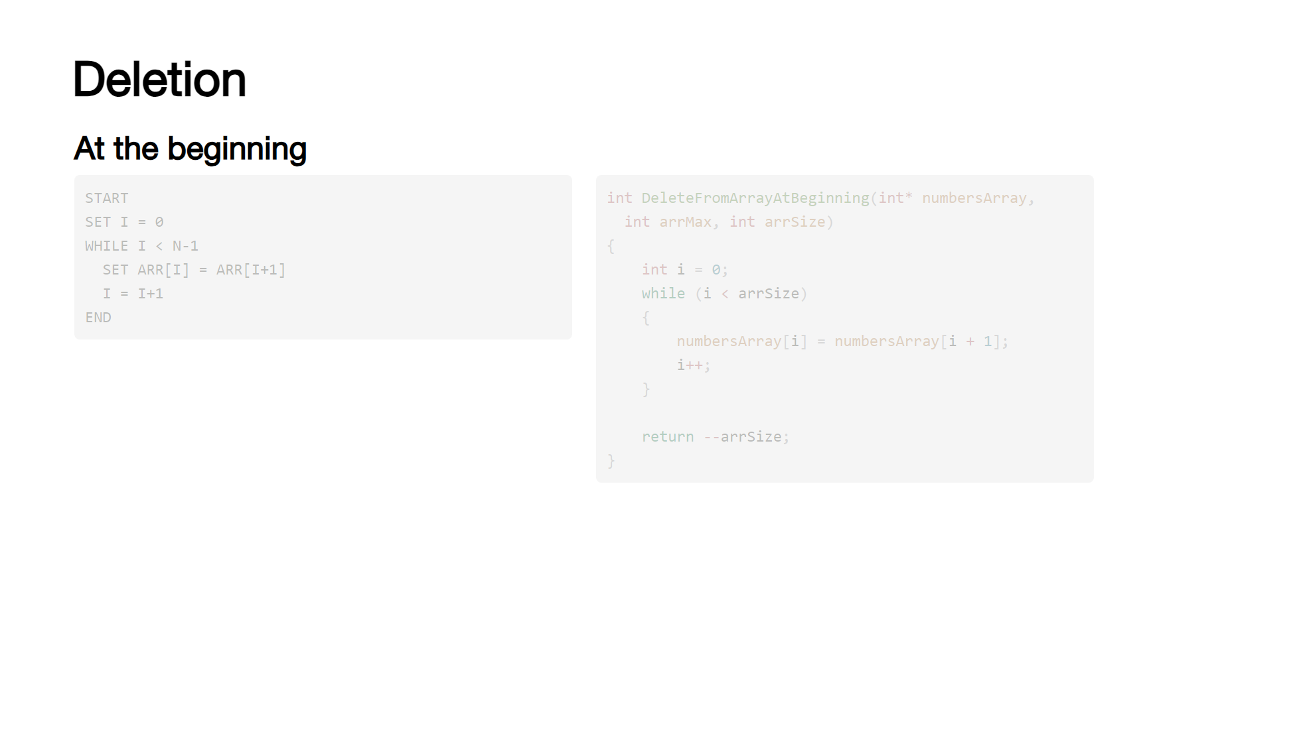
Notes:
Deletion is similar, with algorithms for deleting an element at the start, at a specified position and at the end. [click] [click] The steps for deleting at the beginning are: [click] set the index to 0 [click] while the index is less than the number of elements - 1, copy the element at the next index to the current index [click] deleting at a specific position is similar, rather than starting at 0 we start at position. [click] deleting at the end is a bit simpler, we just decrement the number of elements in the array.

Slide 45
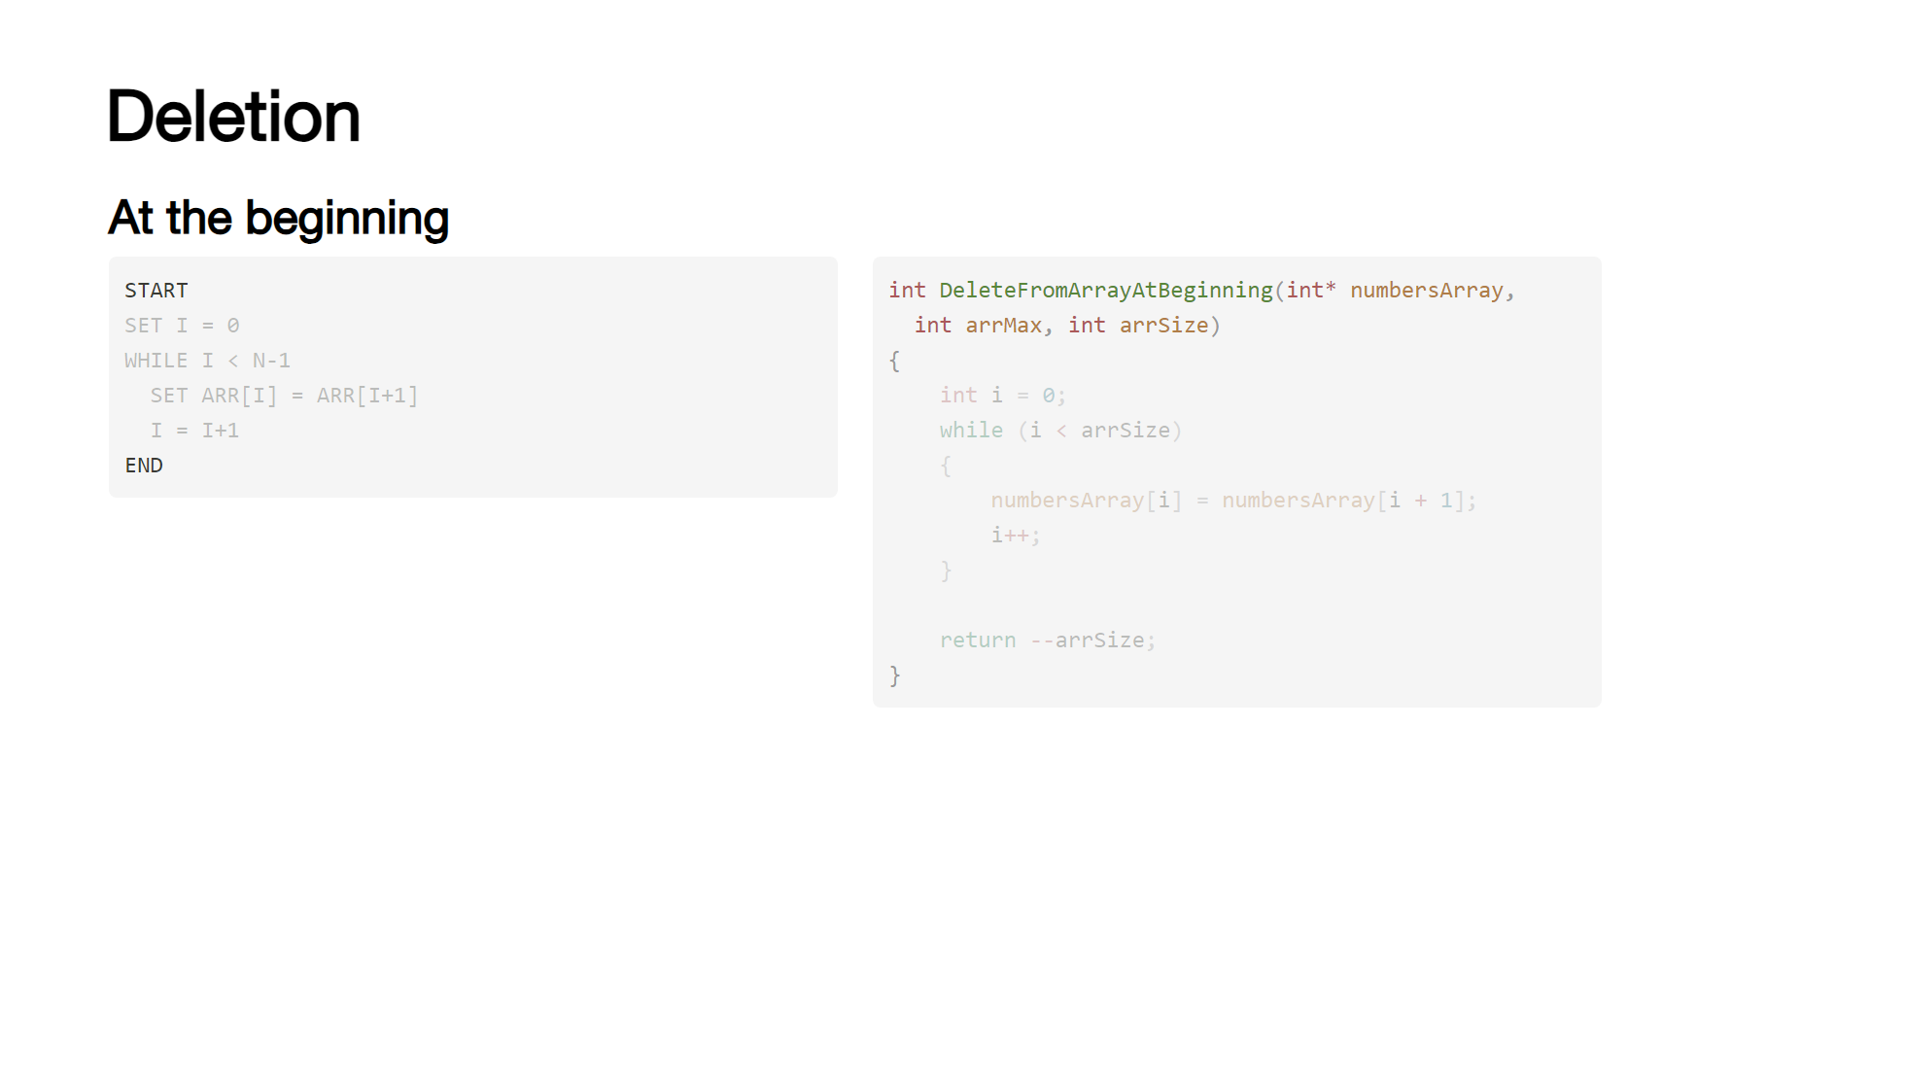
Notes:
Deletion is similar, with algorithms for deleting an element at the start, at a specified position and at the end. [click] [click] The steps for deleting at the beginning are: [click] set the index to 0 [click] while the index is less than the number of elements - 1, copy the element at the next index to the current index [click] deleting at a specific position is similar, rather than starting at 0 we start at position. [click] deleting at the end is a bit simpler, we just decrement the number of elements in the array.

Slide 46

Notes:
Deletion is similar, with algorithms for deleting an element at the start, at a specified position and at the end. [click] [click] The steps for deleting at the beginning are: [click] set the index to 0 [click] while the index is less than the number of elements - 1, copy the element at the next index to the current index [click] deleting at a specific position is similar, rather than starting at 0 we start at position. [click] deleting at the end is a bit simpler, we just decrement the number of elements in the array.

Slide 47
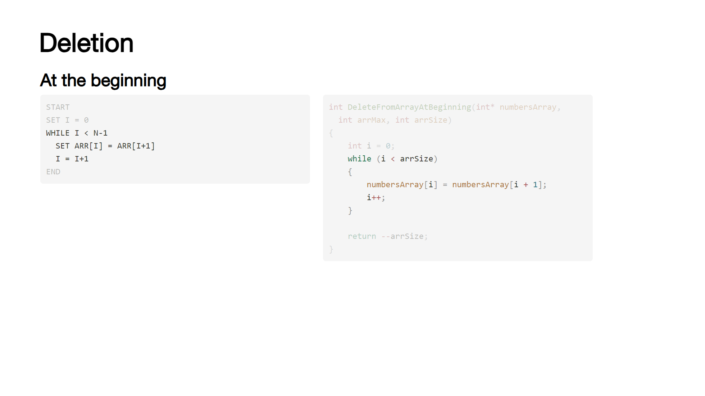
Notes:
Deletion is similar, with algorithms for deleting an element at the start, at a specified position and at the end. [click] [click] The steps for deleting at the beginning are: [click] set the index to 0 [click] while the index is less than the number of elements - 1, copy the element at the next index to the current index [click] deleting at a specific position is similar, rather than starting at 0 we start at position. [click] deleting at the end is a bit simpler, we just decrement the number of elements in the array.

Slide 48
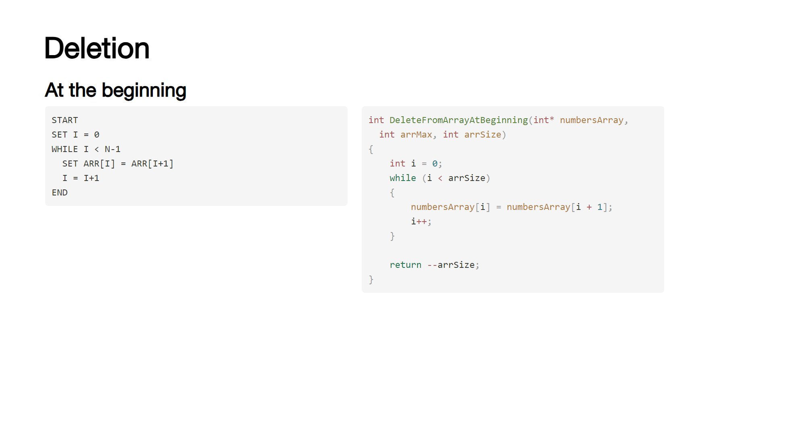
Notes:
Deletion is similar, with algorithms for deleting an element at the start, at a specified position and at the end. [click] [click] The steps for deleting at the beginning are: [click] set the index to 0 [click] while the index is less than the number of elements - 1, copy the element at the next index to the current index [click] deleting at a specific position is similar, rather than starting at 0 we start at position. [click] deleting at the end is a bit simpler, we just decrement the number of elements in the array.

Slide 49

Notes:
Deletion is similar, with algorithms for deleting an element at the start, at a specified position and at the end. [click] [click] The steps for deleting at the beginning are: [click] set the index to 0 [click] while the index is less than the number of elements - 1, copy the element at the next index to the current index [click] deleting at a specific position is similar, rather than starting at 0 we start at position. [click] deleting at the end is a bit simpler, we just decrement the number of elements in the array.

Slide 50
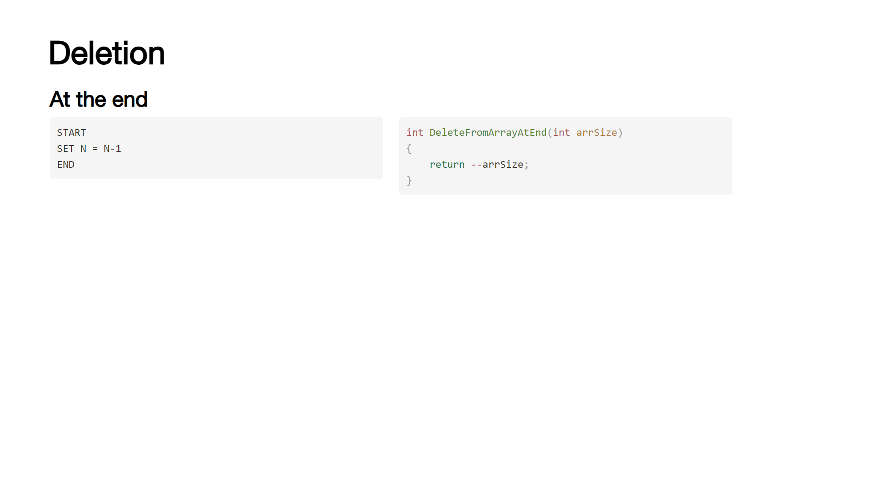
Notes:
Deletion is similar, with algorithms for deleting an element at the start, at a specified position and at the end. [click] [click] The steps for deleting at the beginning are: [click] set the index to 0 [click] while the index is less than the number of elements - 1, copy the element at the next index to the current index [click] deleting at a specific position is similar, rather than starting at 0 we start at position. [click] deleting at the end is a bit simpler, we just decrement the number of elements in the array.

Slide 51
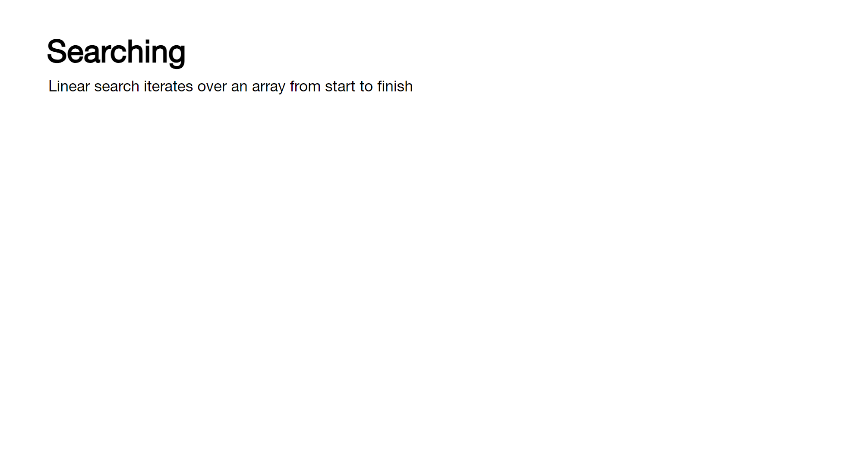
Notes:
There are a couple of ways of searching an array, but we'll just look at the linear approach for now (the other is a binary search, which requires a sorted array and is more complex) [click] It's fairly straight forward to sequentially search an array: The function takes the value to find, the array and the array size. [click] A for loop is used to iterate from 0 to the size of the array [click] At each iteration, we compare the value in the array against the desired value, if we find it we return the index we found it at. Otherwise, we return -1

Slide 52
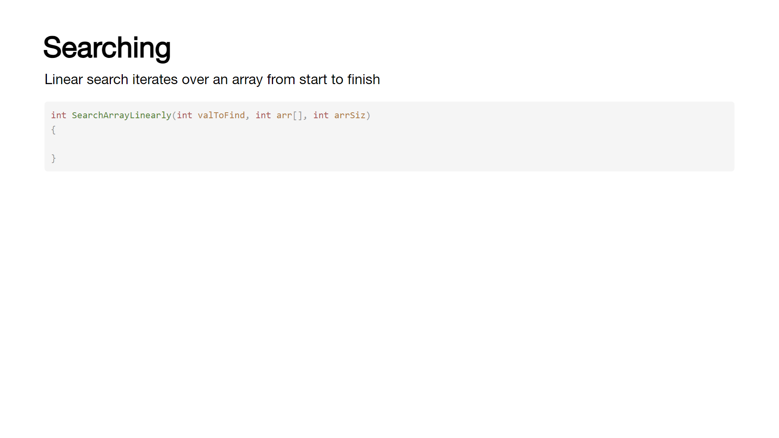
Notes:
There are a couple of ways of searching an array, but we'll just look at the linear approach for now (the other is a binary search, which requires a sorted array and is more complex) [click] It's fairly straight forward to sequentially search an array: The function takes the value to find, the array and the array size. [click] A for loop is used to iterate from 0 to the size of the array [click] At each iteration, we compare the value in the array against the desired value, if we find it we return the index we found it at. Otherwise, we return -1

Slide 53
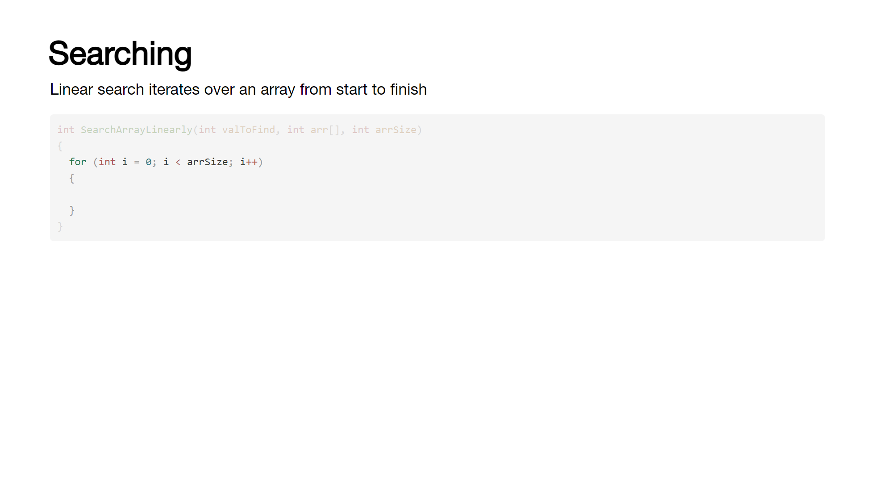
Notes:
There are a couple of ways of searching an array, but we'll just look at the linear approach for now (the other is a binary search, which requires a sorted array and is more complex) [click] It's fairly straight forward to sequentially search an array: The function takes the value to find, the array and the array size. [click] A for loop is used to iterate from 0 to the size of the array [click] At each iteration, we compare the value in the array against the desired value, if we find it we return the index we found it at. Otherwise, we return -1

Slide 54
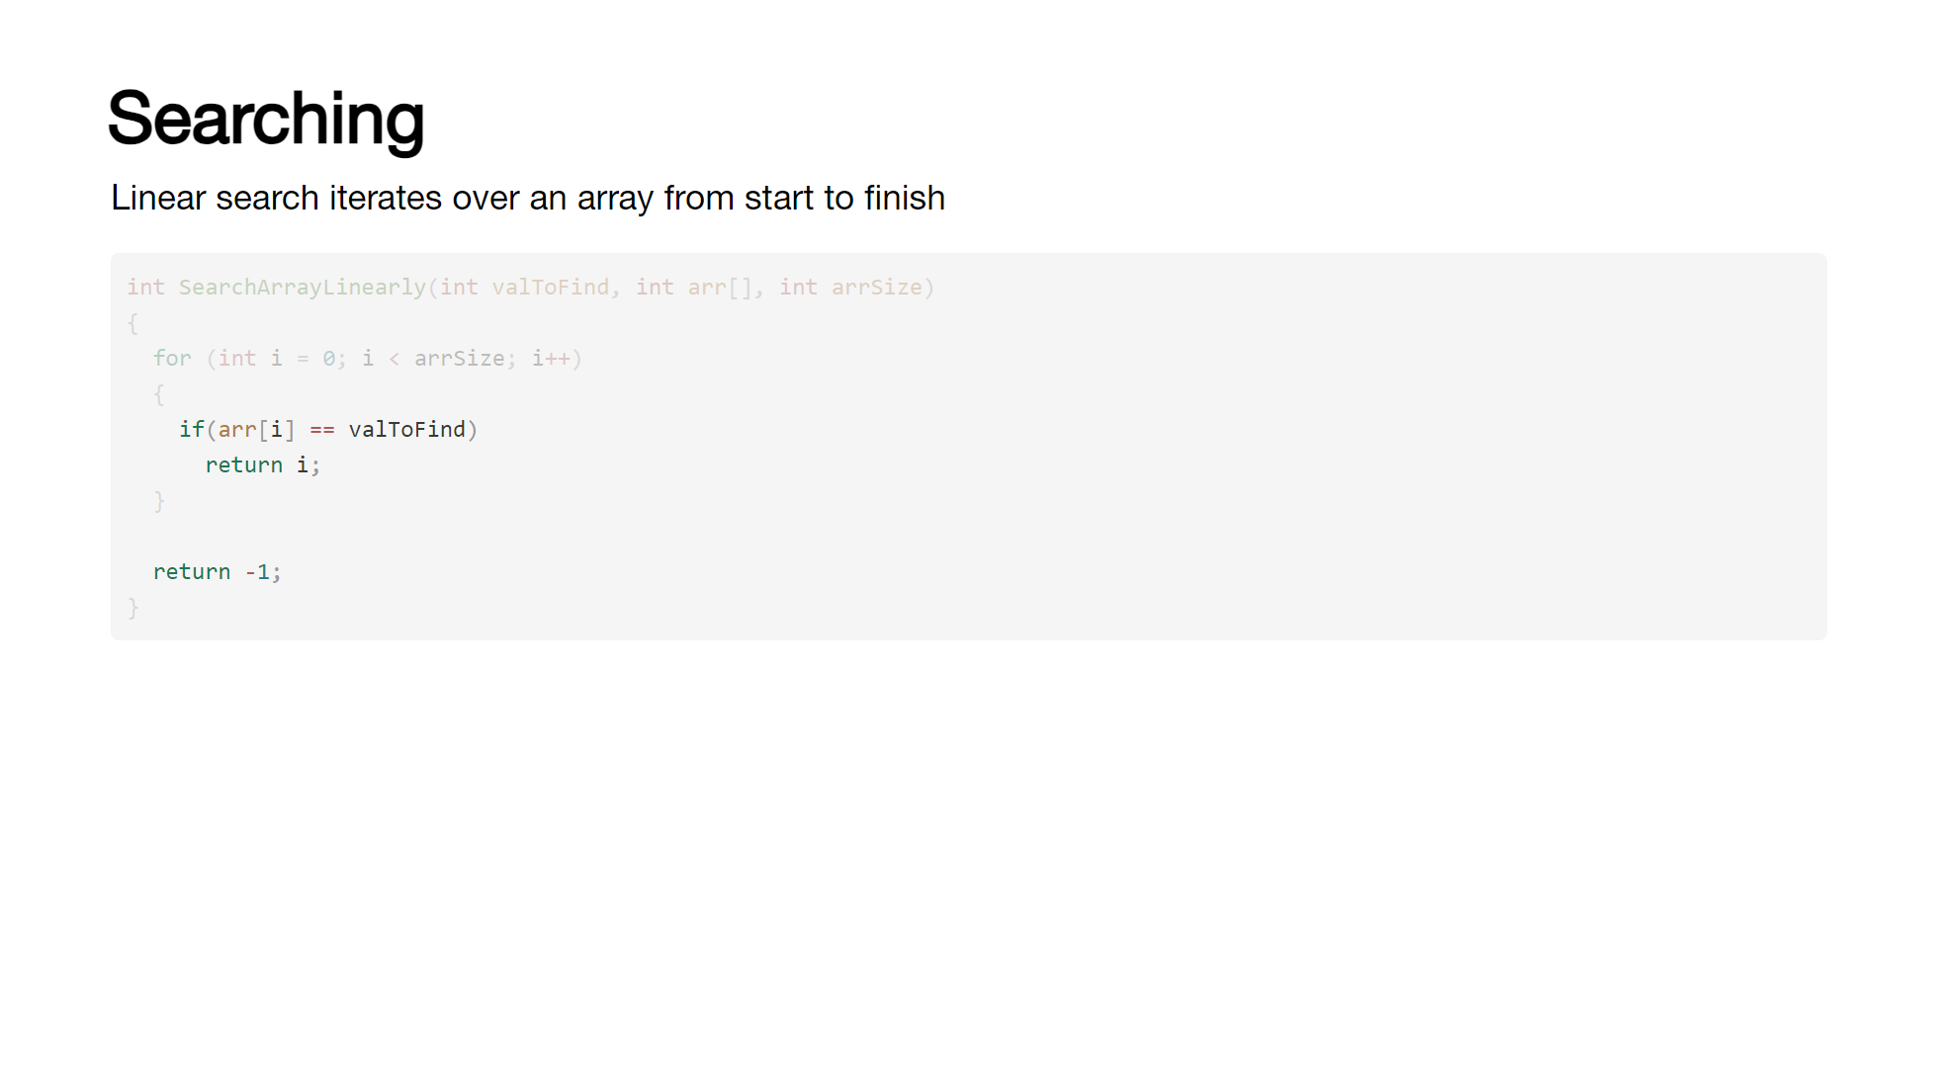
Notes:
There are a couple of ways of searching an array, but we'll just look at the linear approach for now (the other is a binary search, which requires a sorted array and is more complex) [click] It's fairly straight forward to sequentially search an array: The function takes the value to find, the array and the array size. [click] A for loop is used to iterate from 0 to the size of the array [click] At each iteration, we compare the value in the array against the desired value, if we find it we return the index we found it at. Otherwise, we return -1

Slide 55
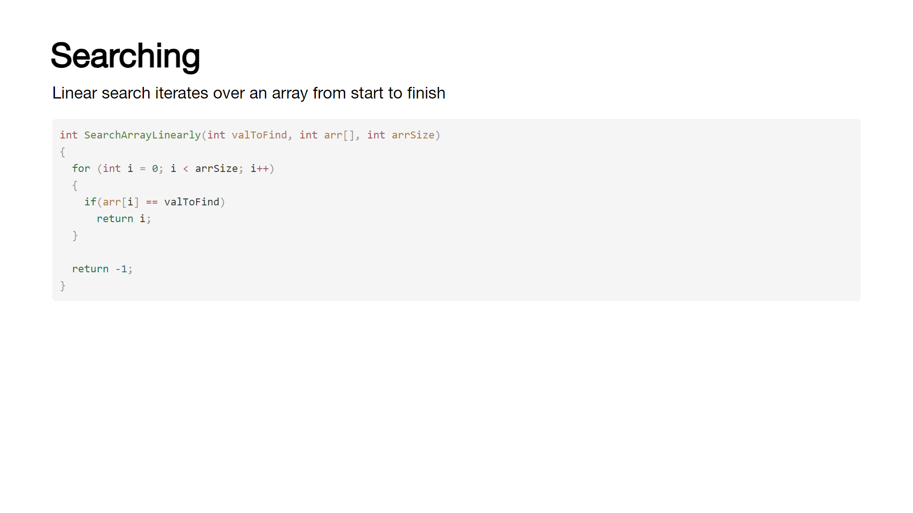
Notes:
There are a couple of ways of searching an array, but we'll just look at the linear approach for now (the other is a binary search, which requires a sorted array and is more complex) [click] It's fairly straight forward to sequentially search an array: The function takes the value to find, the array and the array size. [click] A for loop is used to iterate from 0 to the size of the array [click] At each iteration, we compare the value in the array against the desired value, if we find it we return the index we found it at. Otherwise, we return -1

Slide 56
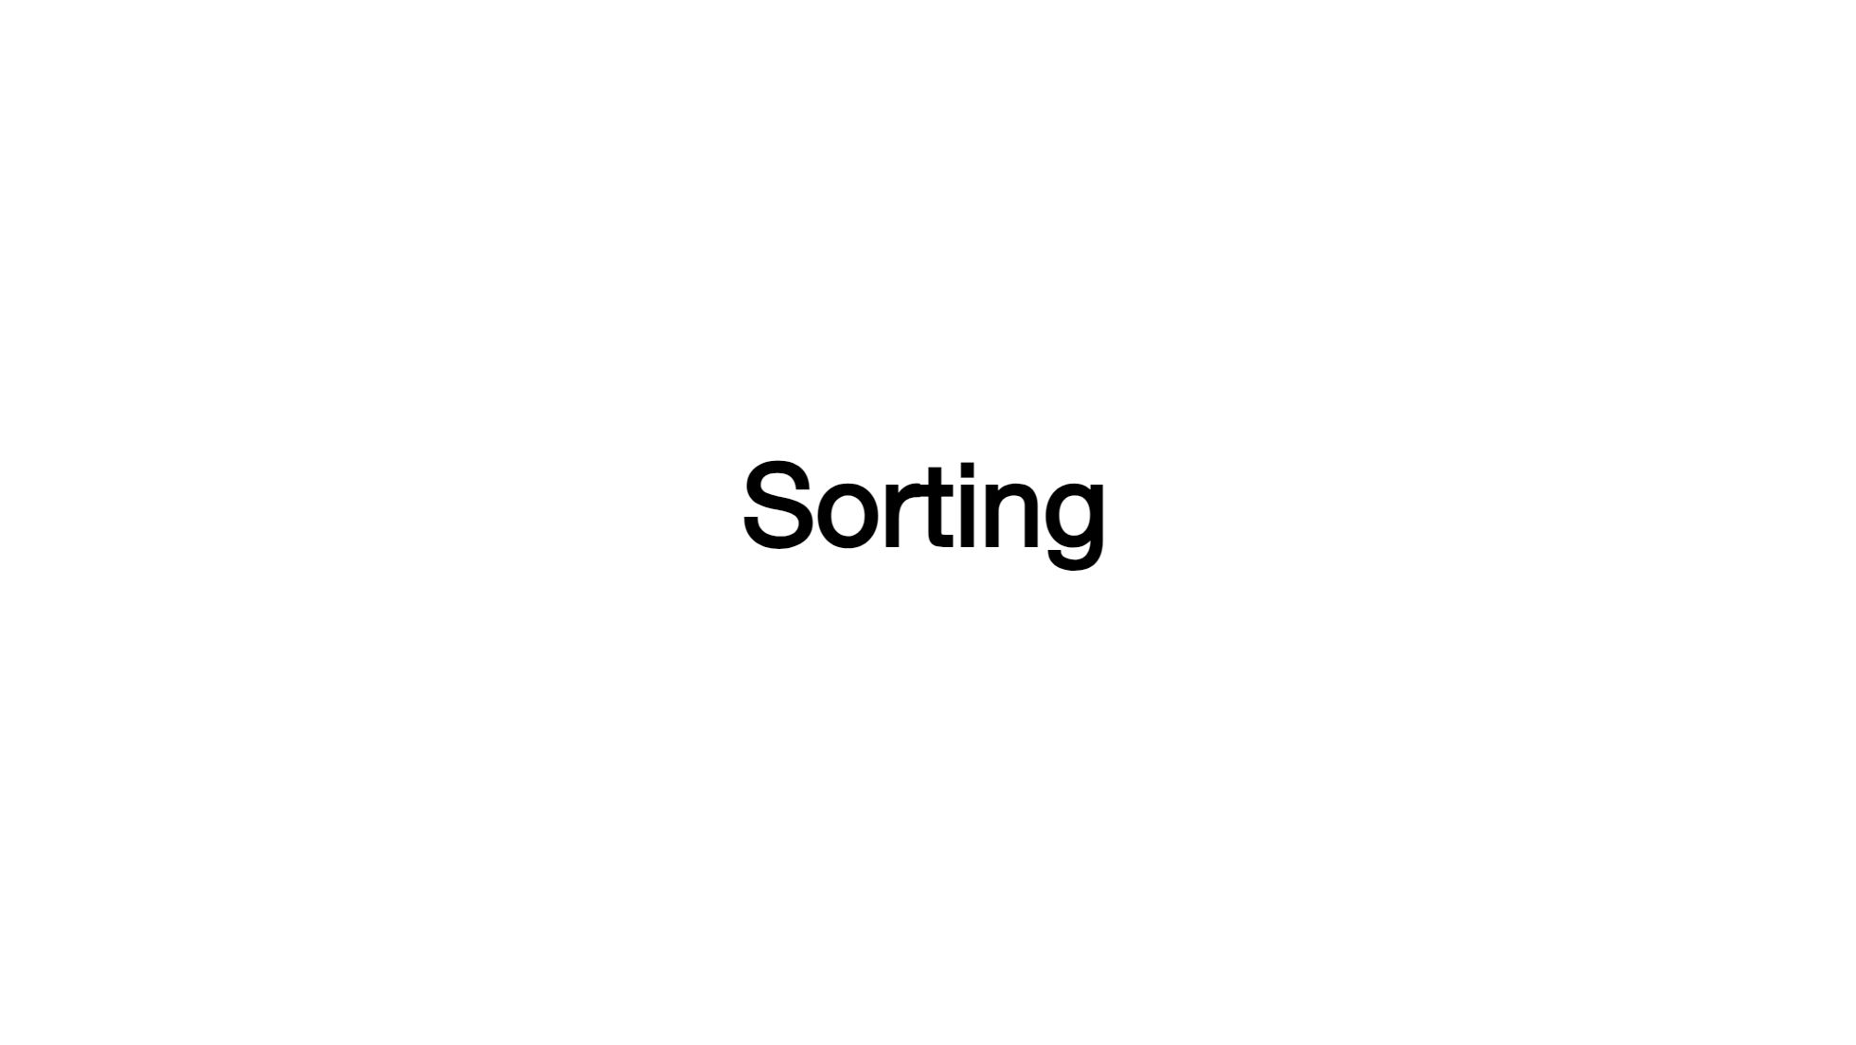
Notes:
Sorting is it's own entire thing, so we'll call a break here and come back to that shortly!

